Slide 1
2023 North Pacific SWO assessment
ISC BILLWG
Slides updated as work progresses

Slide 2
Modeling Team Meeting I
Jan 17/18, 2023

Slide 3
Status Update
Organization:
Github
Quarto
Goal is to make the assessments transparent, easily replicated/modified in future years, and easy to onboard new BILLWG members
No more emailing SS3 input files ☺
Development Progress
Data in – model version 3.30.20
Model converges/hessian inverts
Population biomass unrealistic (10²³)
Dropped JPN EPO size comp (sample size)
Separated US LL Deep size comp – sex specific length as its own fleet
Still considering aggregating all size comp or dropping fleet entirely

Slide 4
02/21/23 Status Update
Current actively updated model
Progress:
Model converges
Positive definite Hessian
Gradient <0.0001
Fits data reasonably/no parameters on the bounds
Initial equilibrium catch likelihood problem
Dropped JPN IATTC size data
IATTC size data double normal selectivity (was asymptotic lognormal)
Removed sex-specific size data
Next steps
3. Add back in sex-specific data
2. Use likelihood profile to explore dropping/down-weighting size comp or CPUE indices
1. Adding a few blocks to improve fit to size comp
Continue trying to solve initial equilibrium catch likelihood
For future model development:
2-area model with tagging data
Explore an environmental index for recruitment?

Slide 5
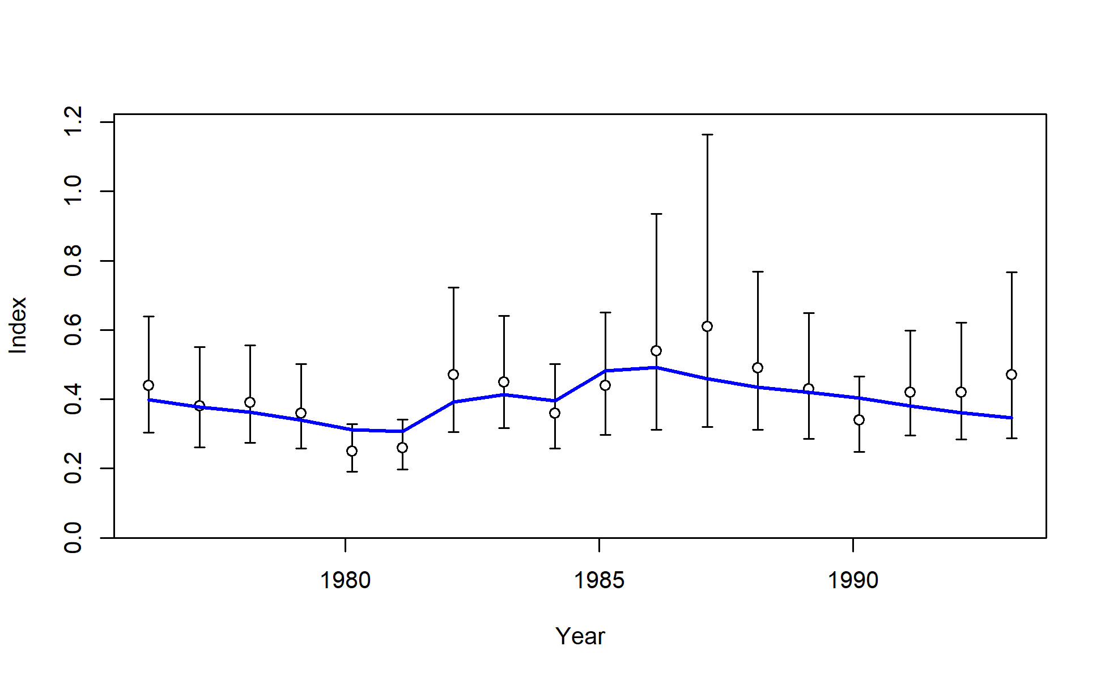
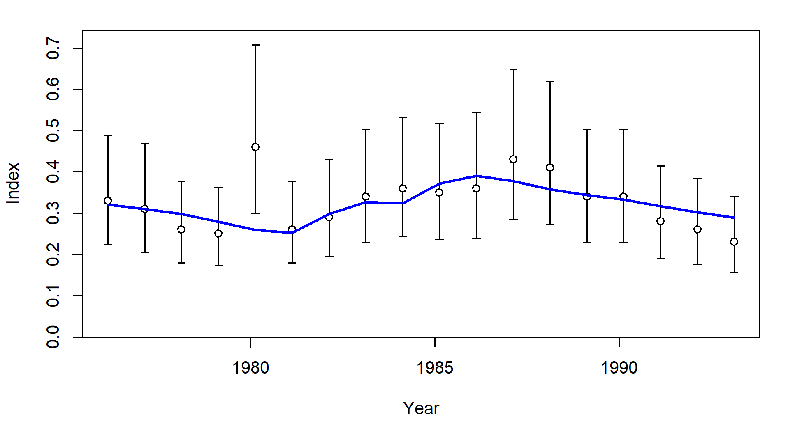
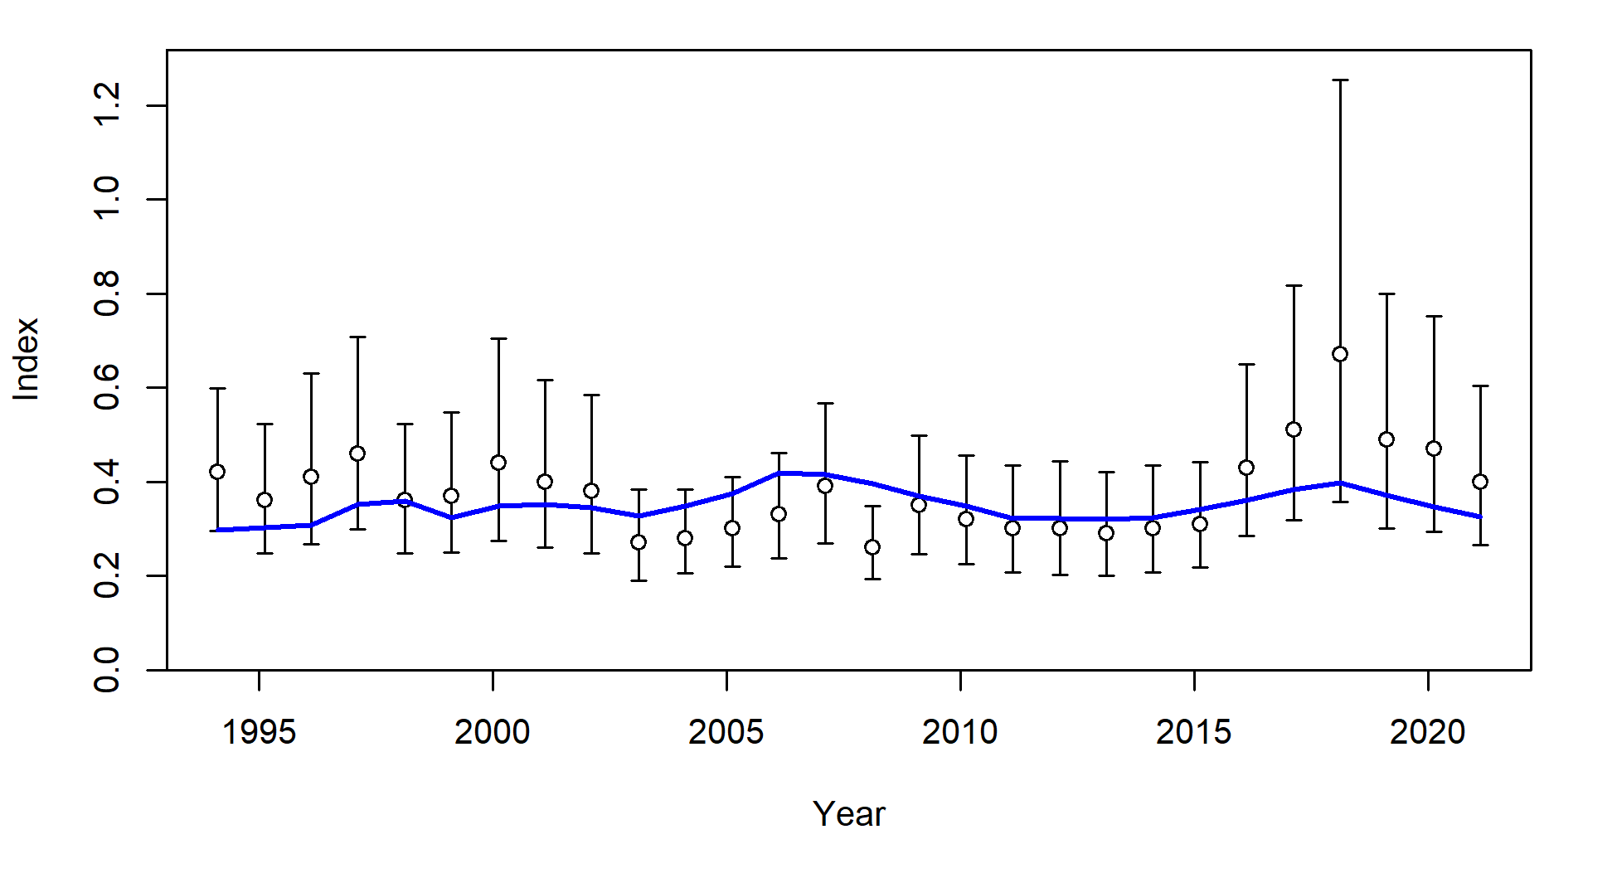
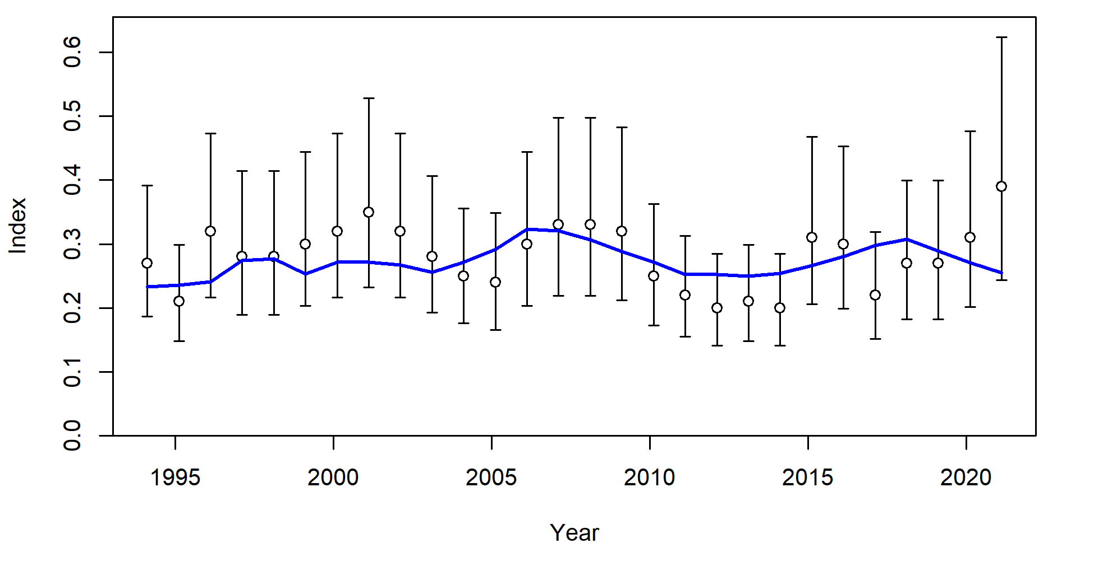
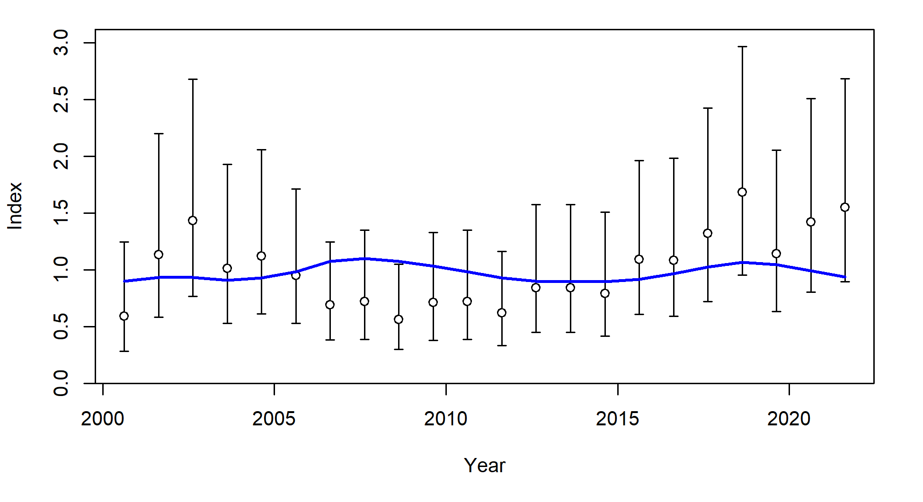
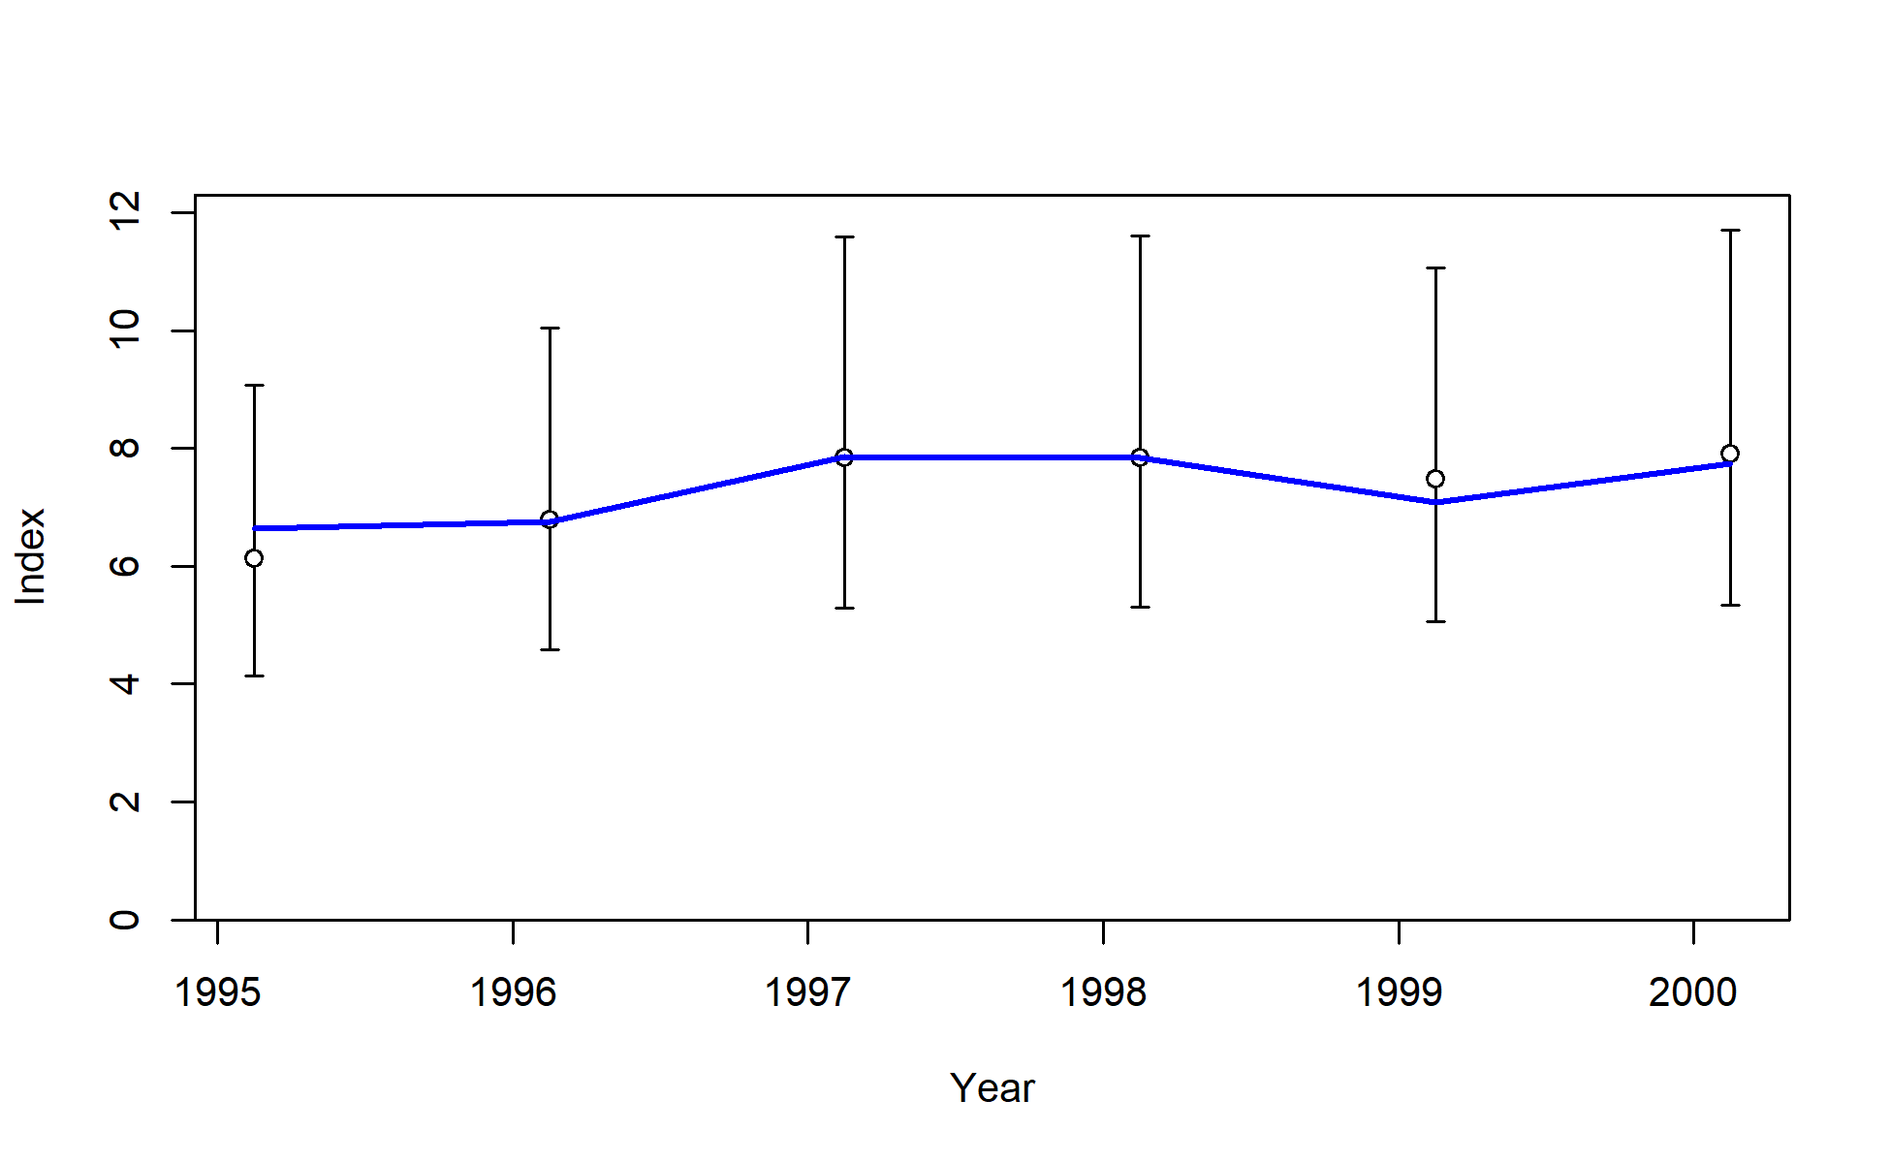
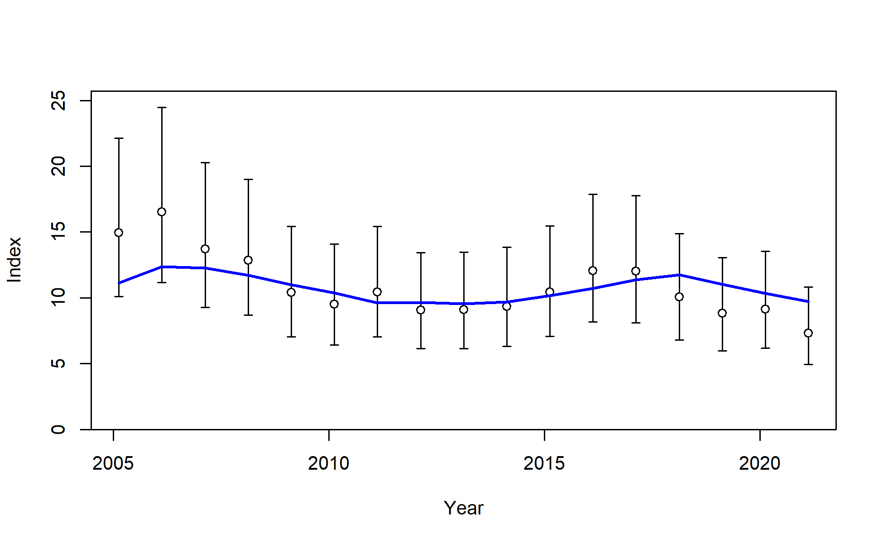
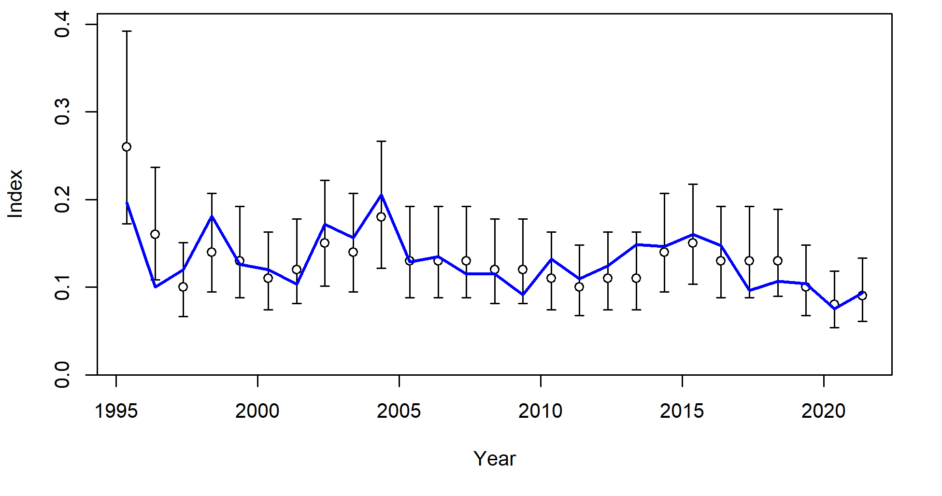
S1_JPN_WCNPO_OSDWLL_early_Area1
S2_JPN_WCNPO_OSDWCOLL_late_Area1
S3_JPN_WCNPO_OSDWLL_early_Area2
S4_JPN_WCNPO_OSDWLL_late_Area2
S5_TWN_WCNPO_DWLL_late
S8_US_WCNPO_LL_shallow_late
S6_US_WCNPO_LL_deep
S7_US_WCNPO_LL_shallow_early

Slide 6
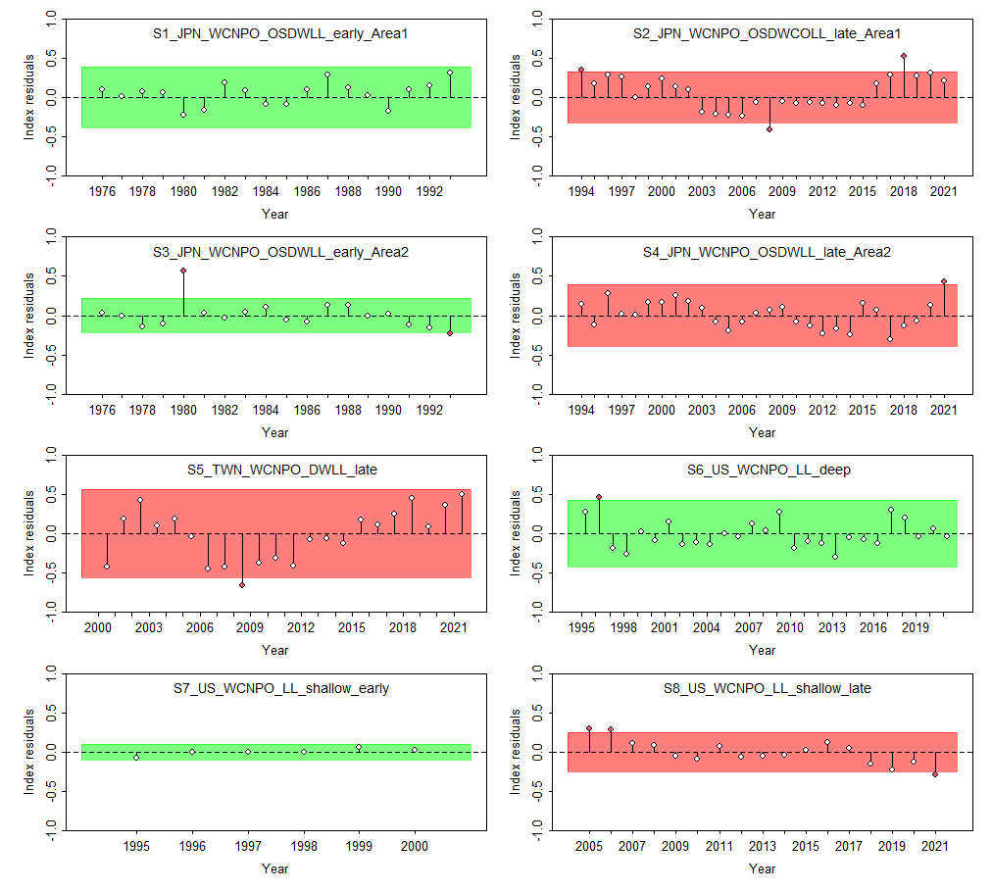

Slide 7
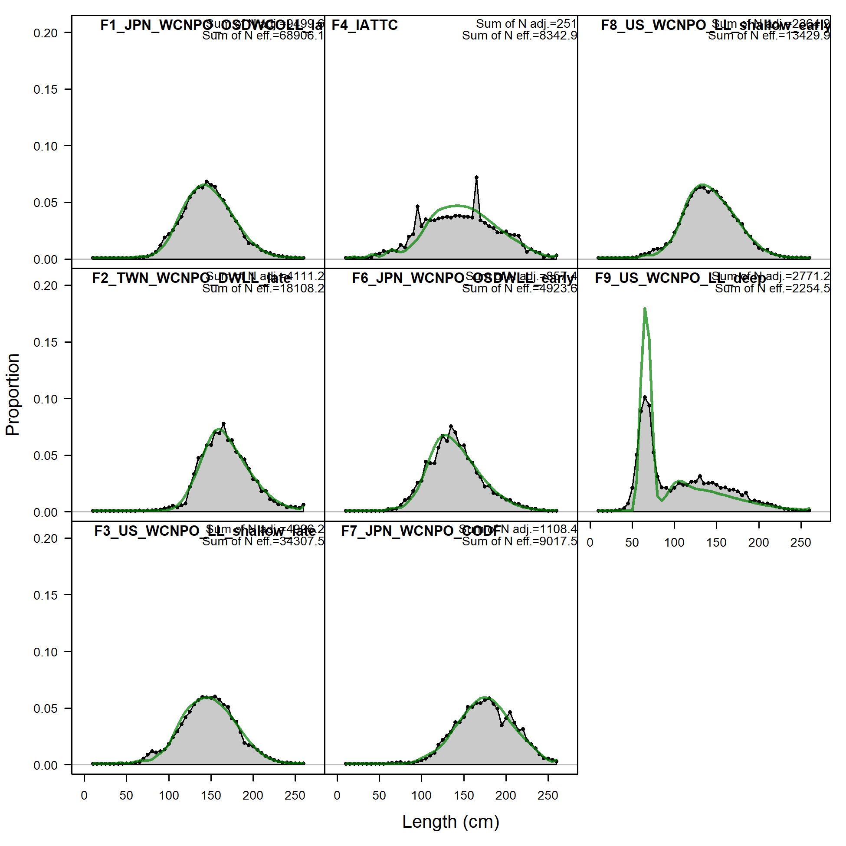

Slide 8
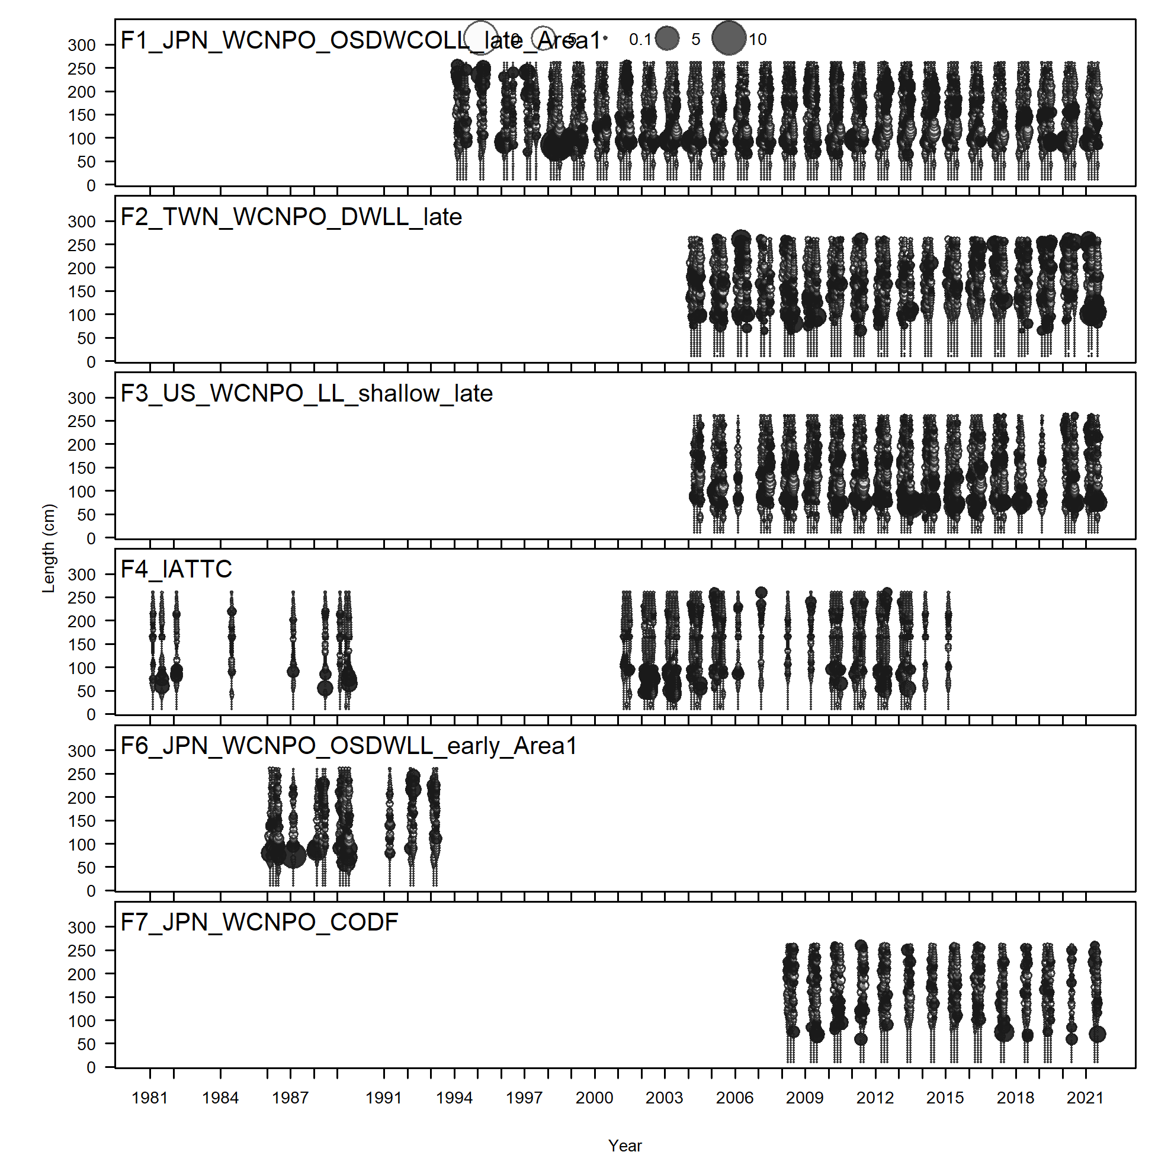
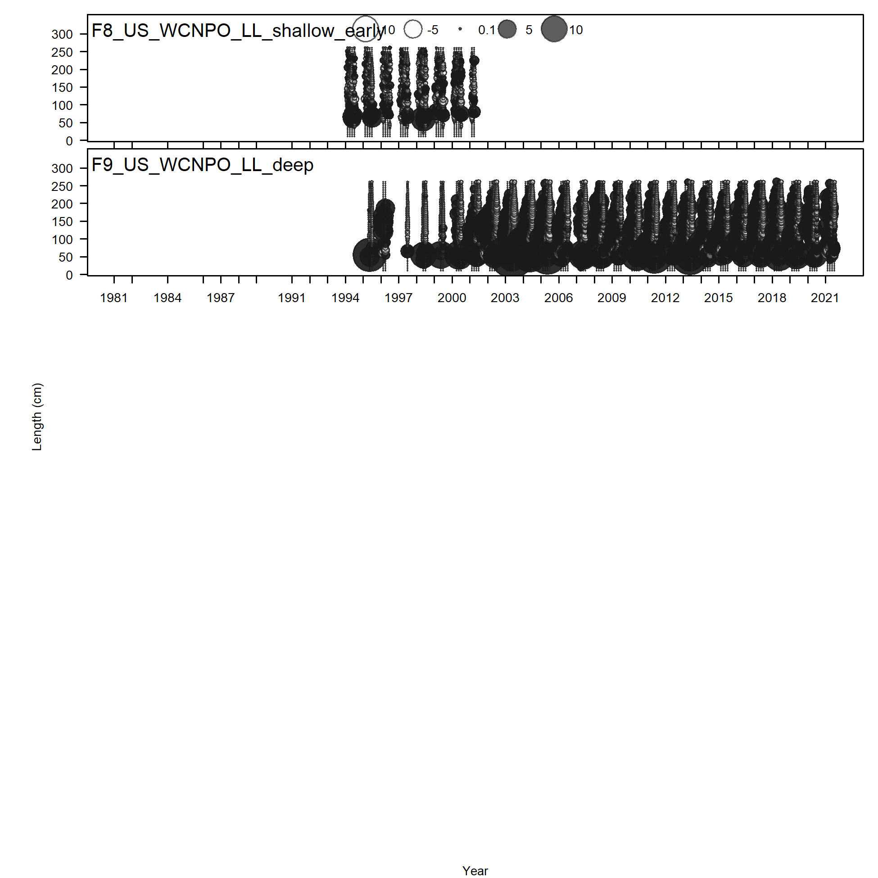

Slide 9
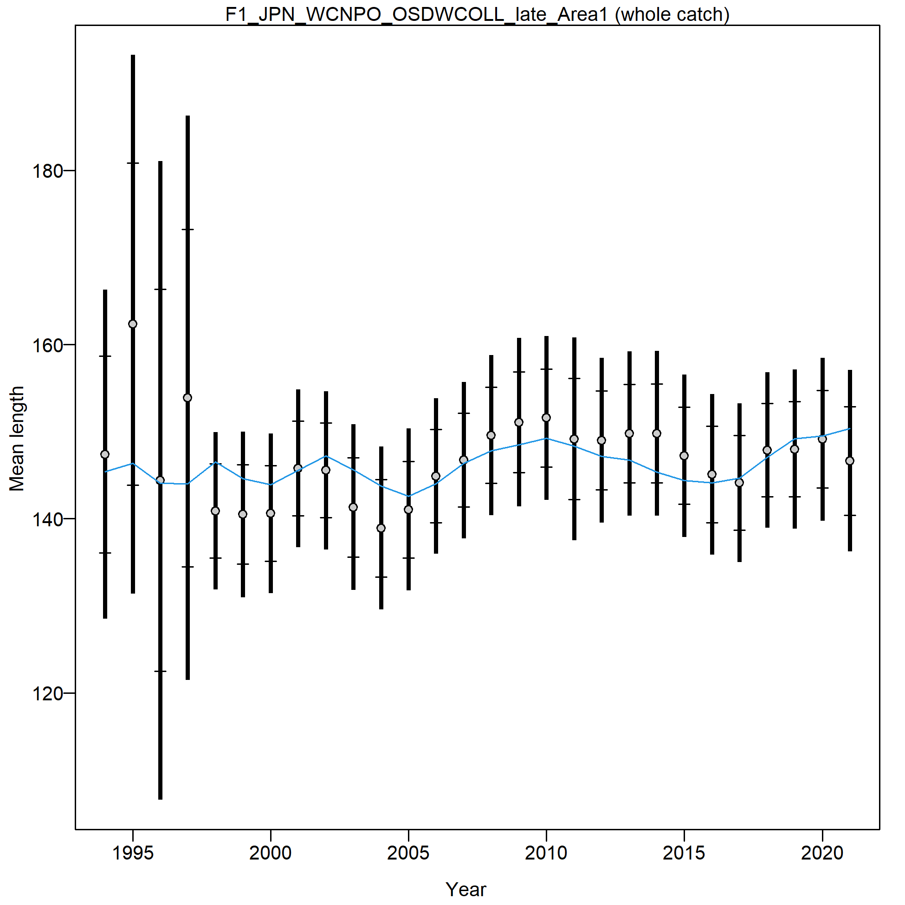
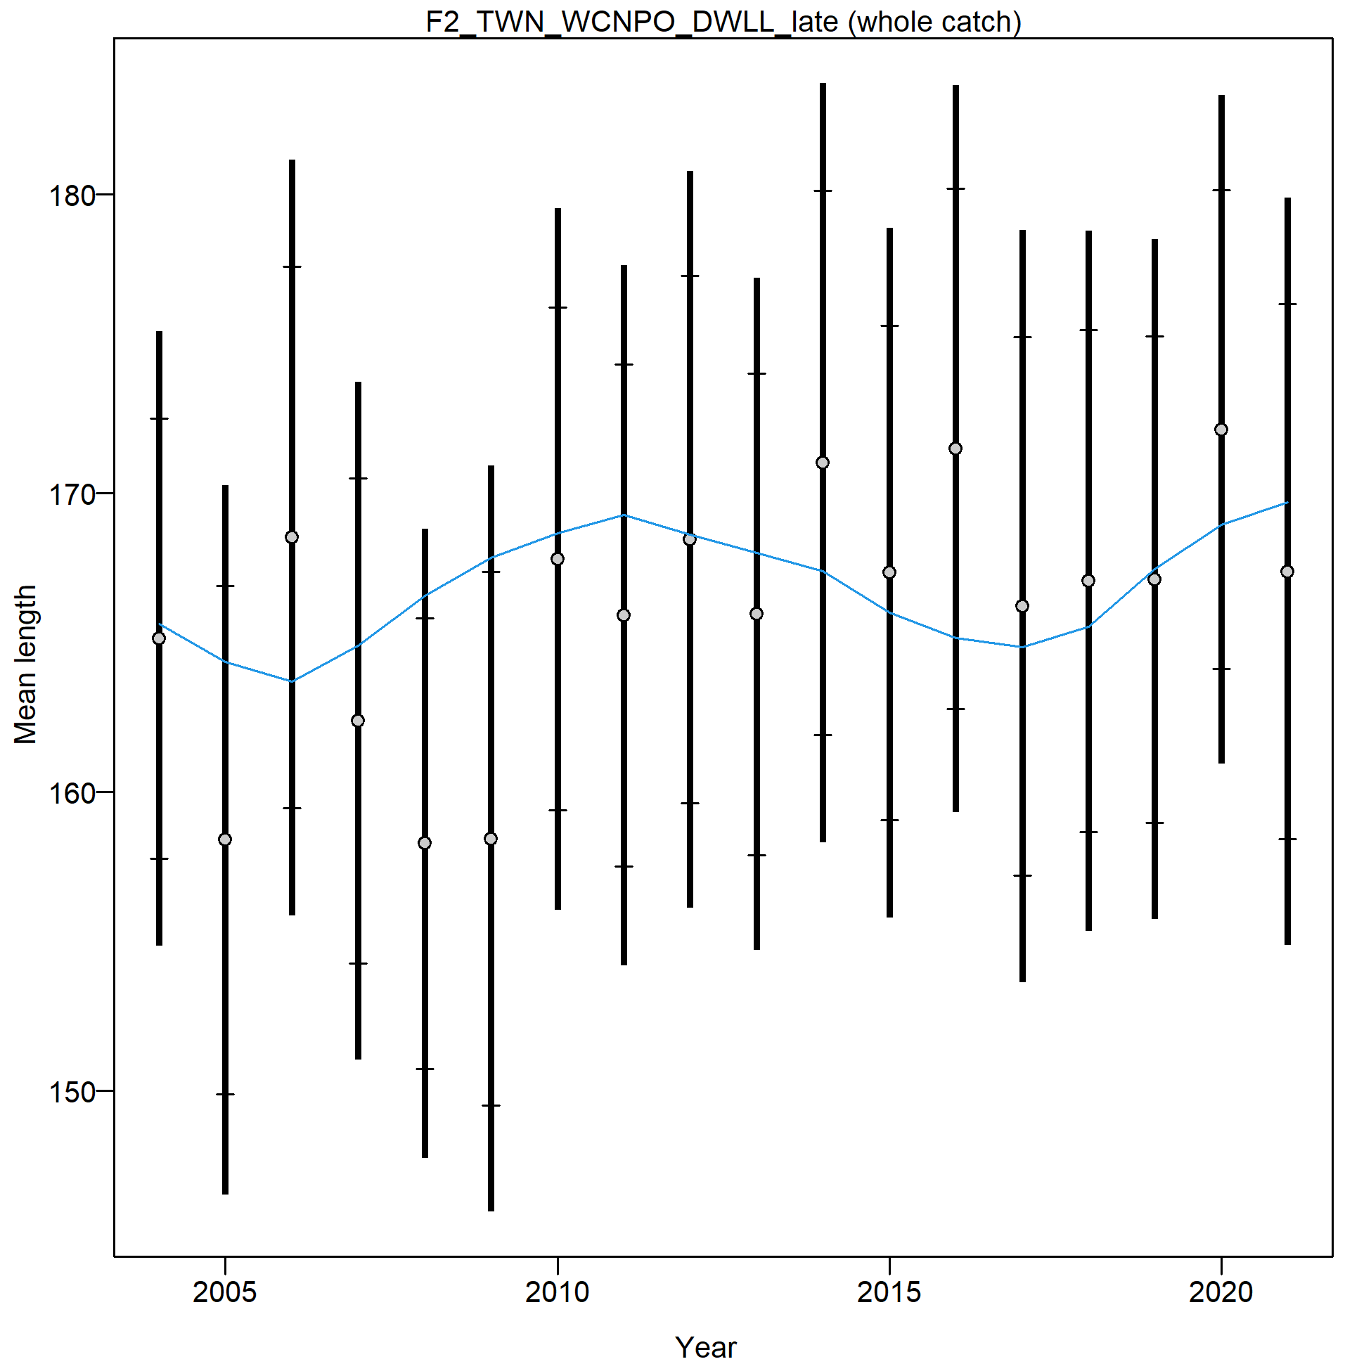
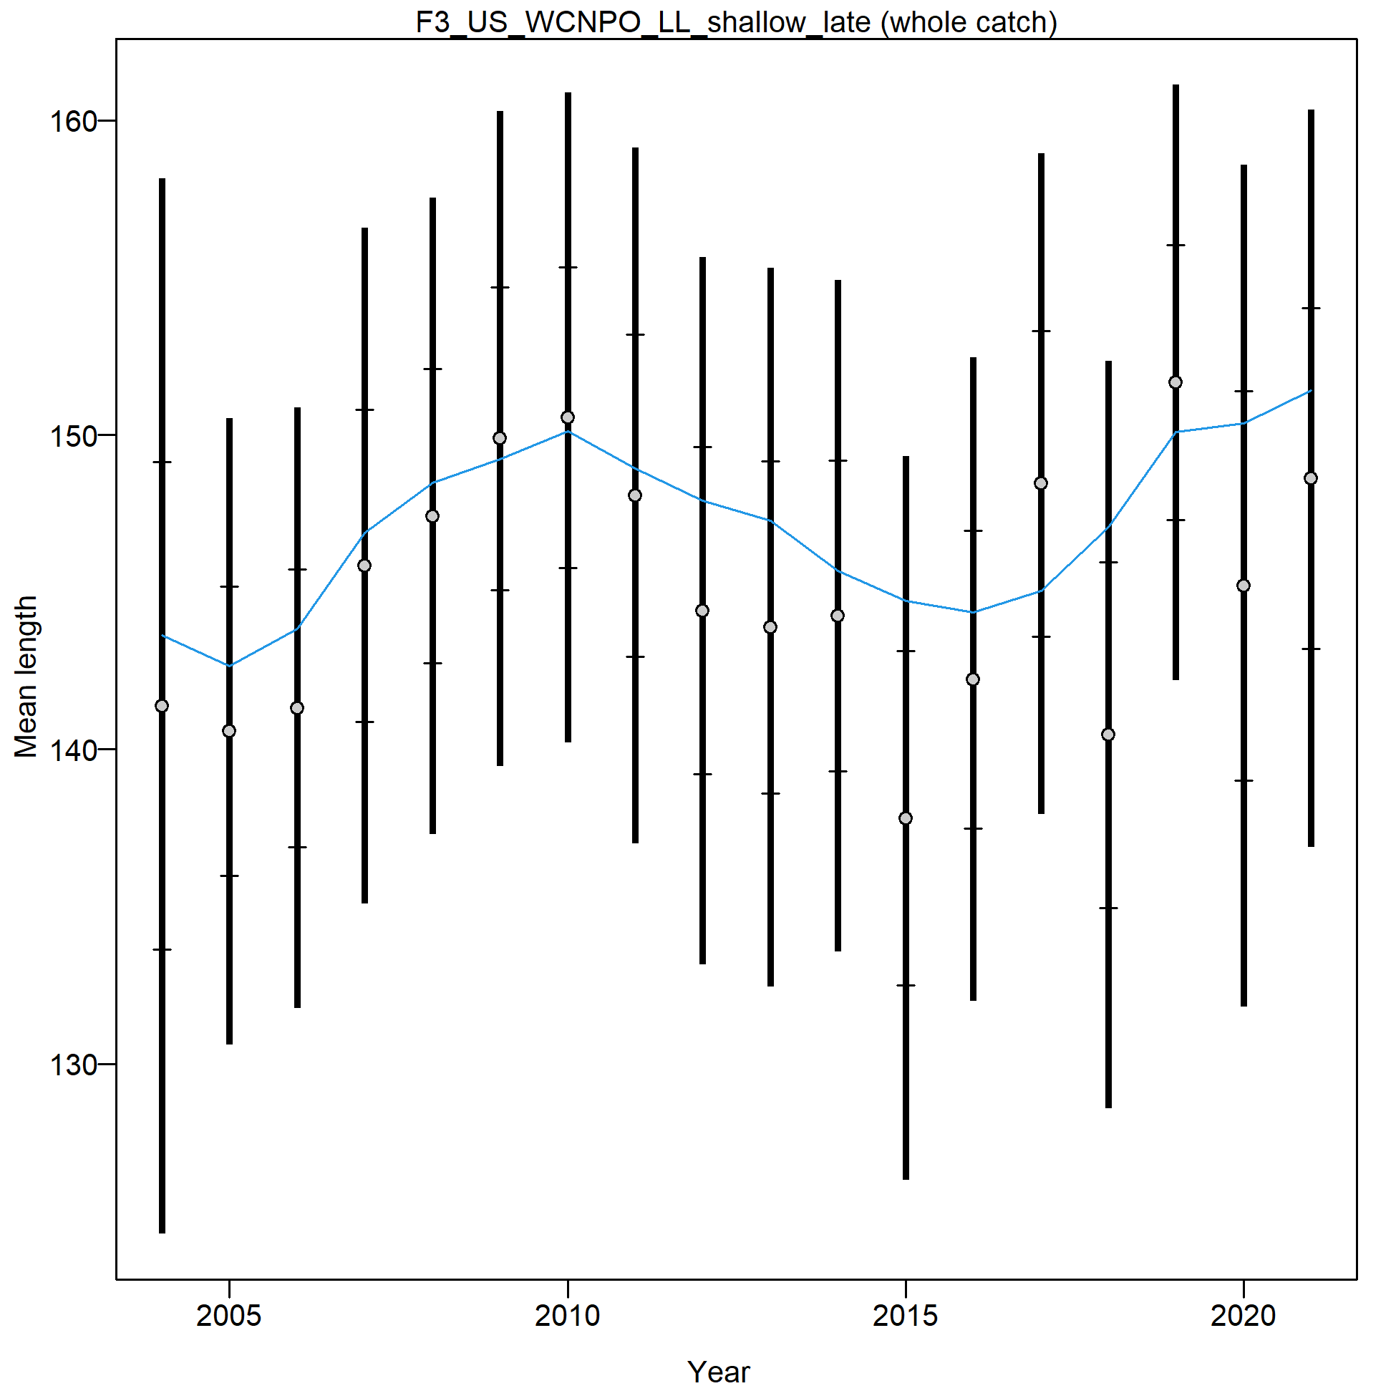
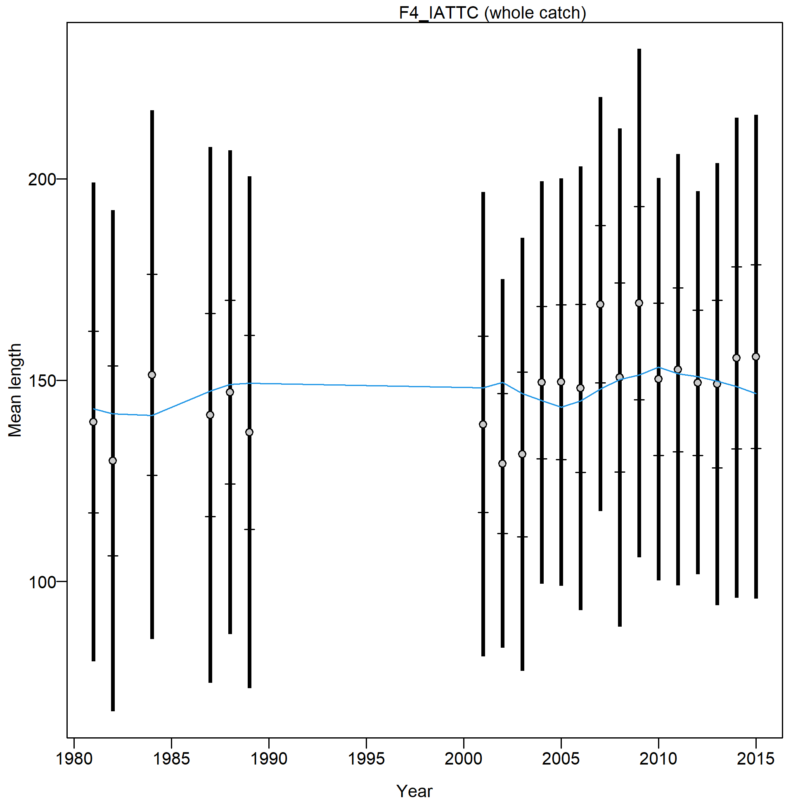
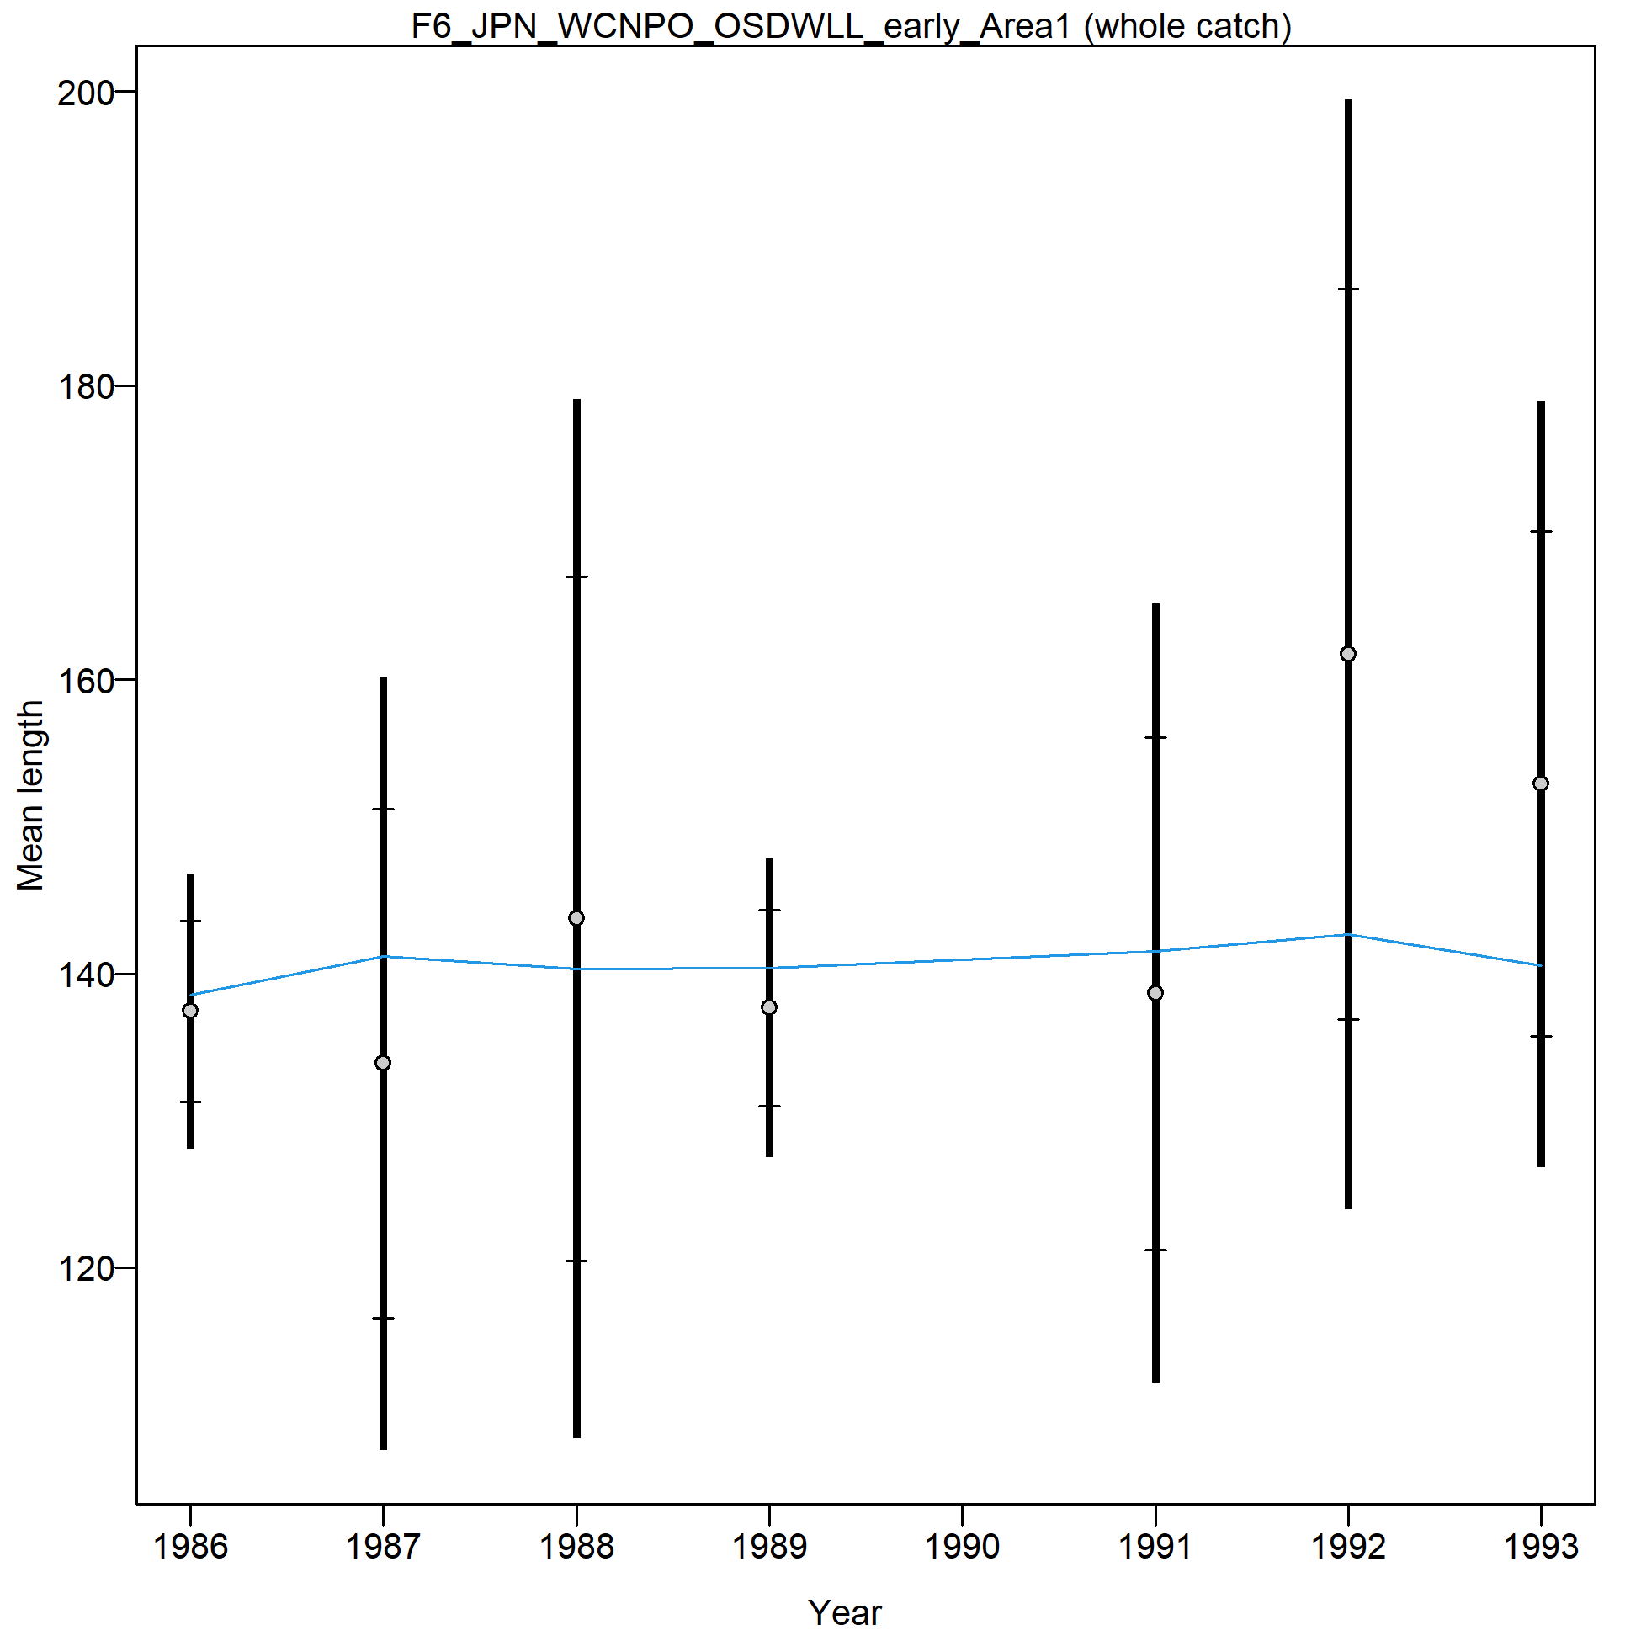
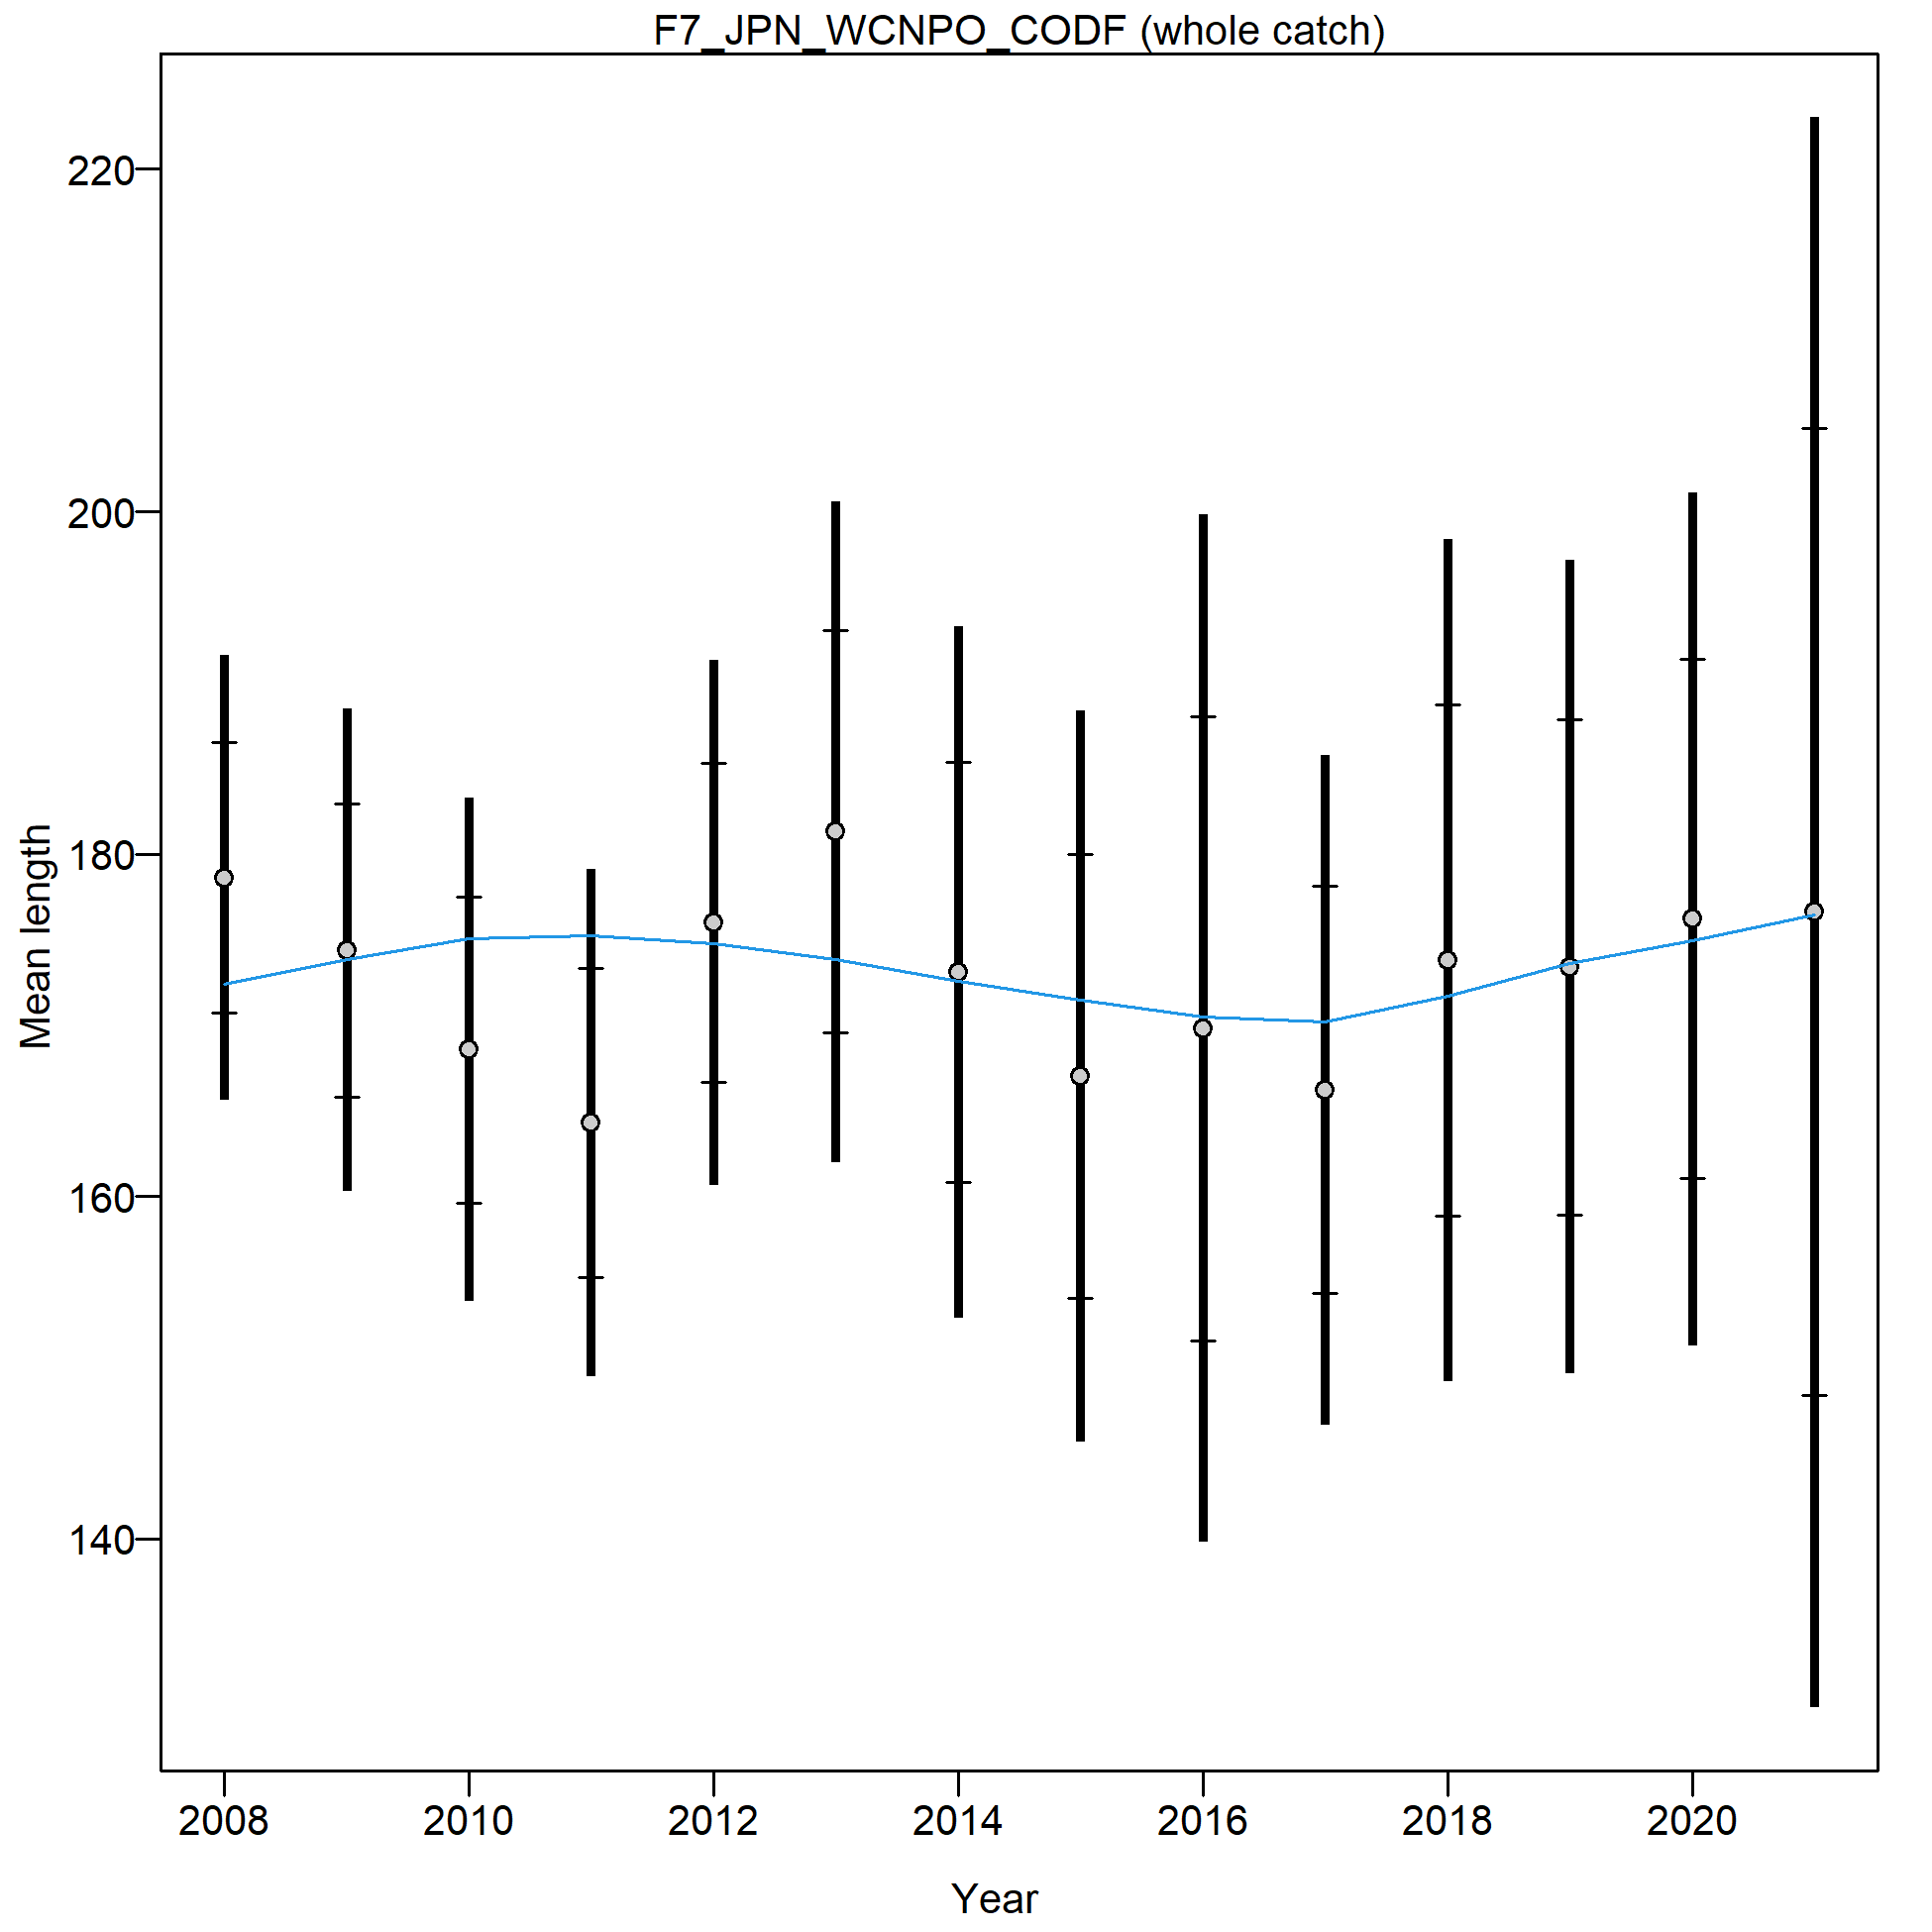
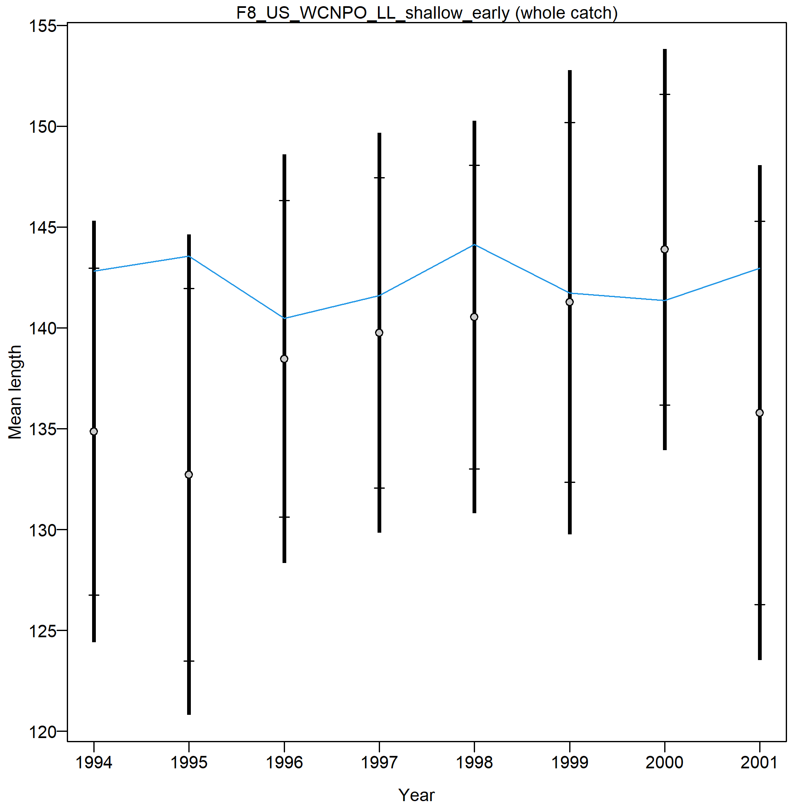
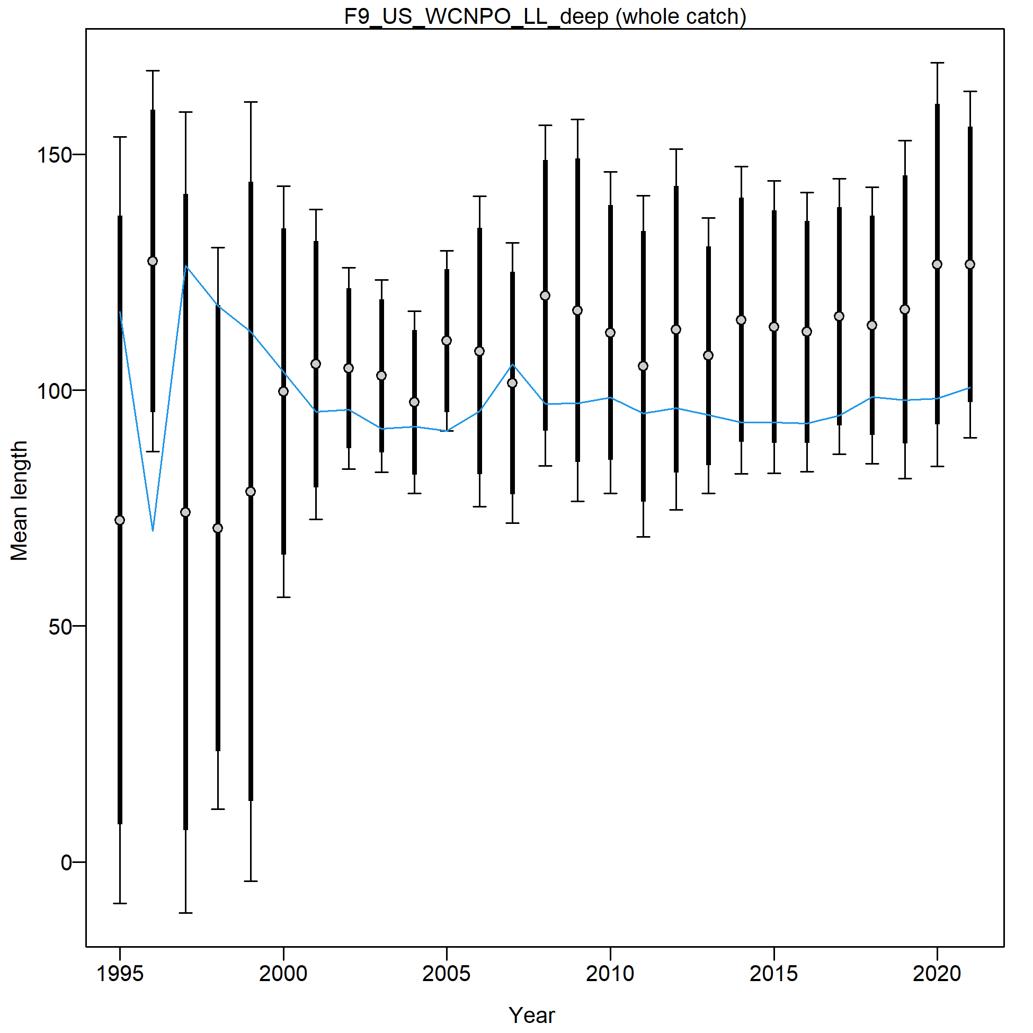

Slide 10
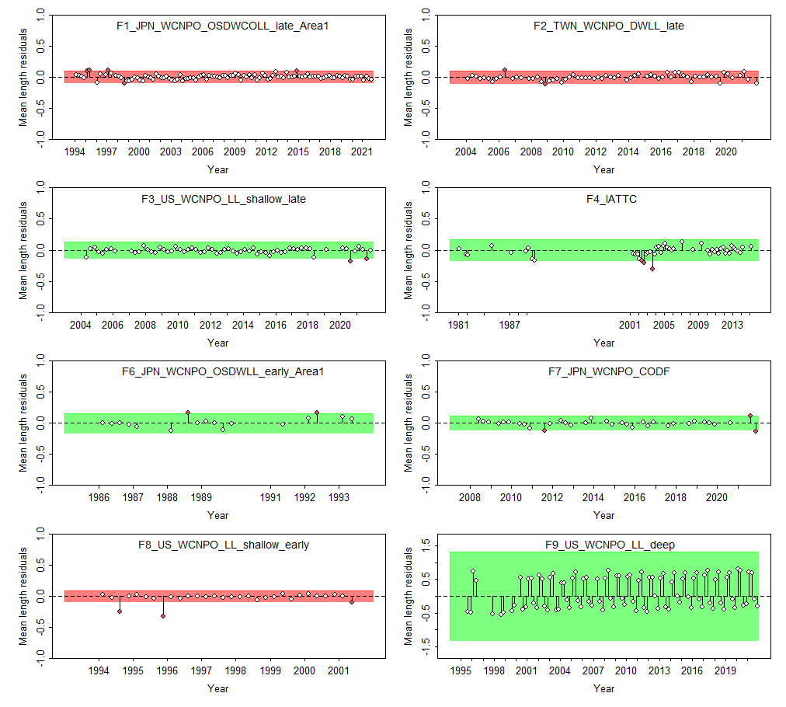

Slide 11
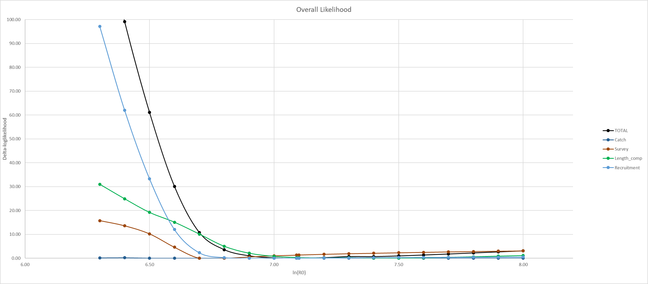
CPUE min: 6.8
Size comp min: 7.4
Rec min: 7.0

Slide 12
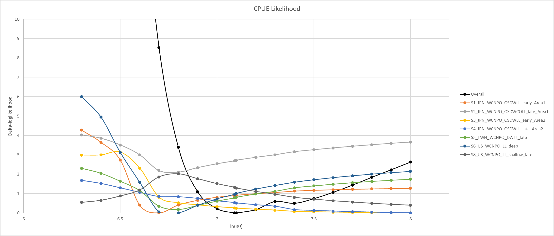

Slide 13
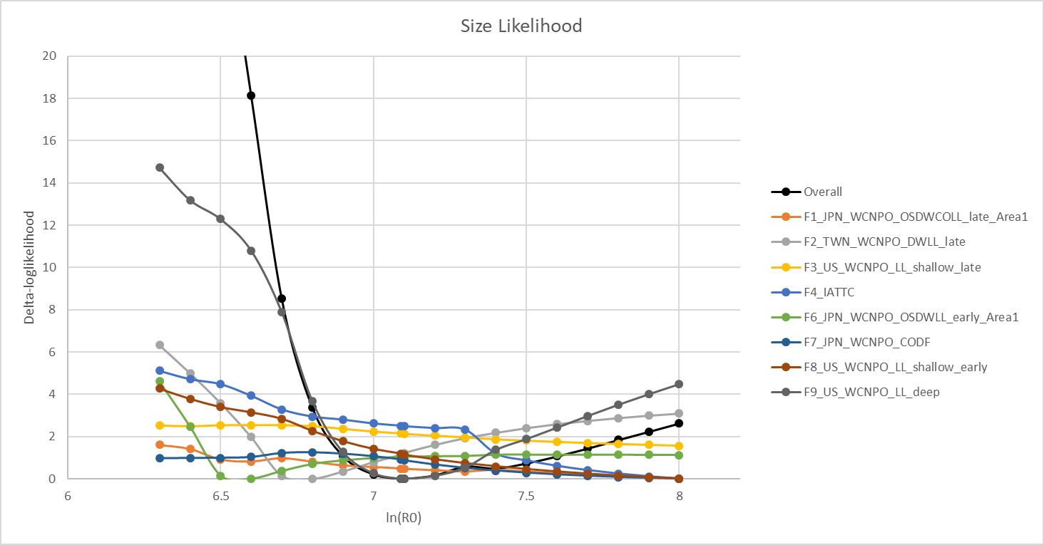
TWN DWLL and US HI LL Deep driving the size comp
Considering dropping/downweighting US deep
JPN LL Area 1 Late, IATTC, JPN LL Area 1 early, and US HI Shallow early all have very large ln(R0) – could be responsible for the model’s tendency to go to unrealistic population sizes
2018 assessment only included F1-F4, dropped all others

Slide 14
Status update 3/14/23
Block on TWN LL size comp
Block on JPN F1 size comp
Tried block on HI LL Deep F9, didn’t improve fit.
Downweight all size comp lambda to 0.5
Reduces the influence of size comp, allows CPUE to drive biomass trends
Dropped IATTC size comp prior to 2001 (9 quarters, 1981-1989)
Set up model with 2-areas and tagging data
Work in progress, doesn’t run yet.

Slide 15
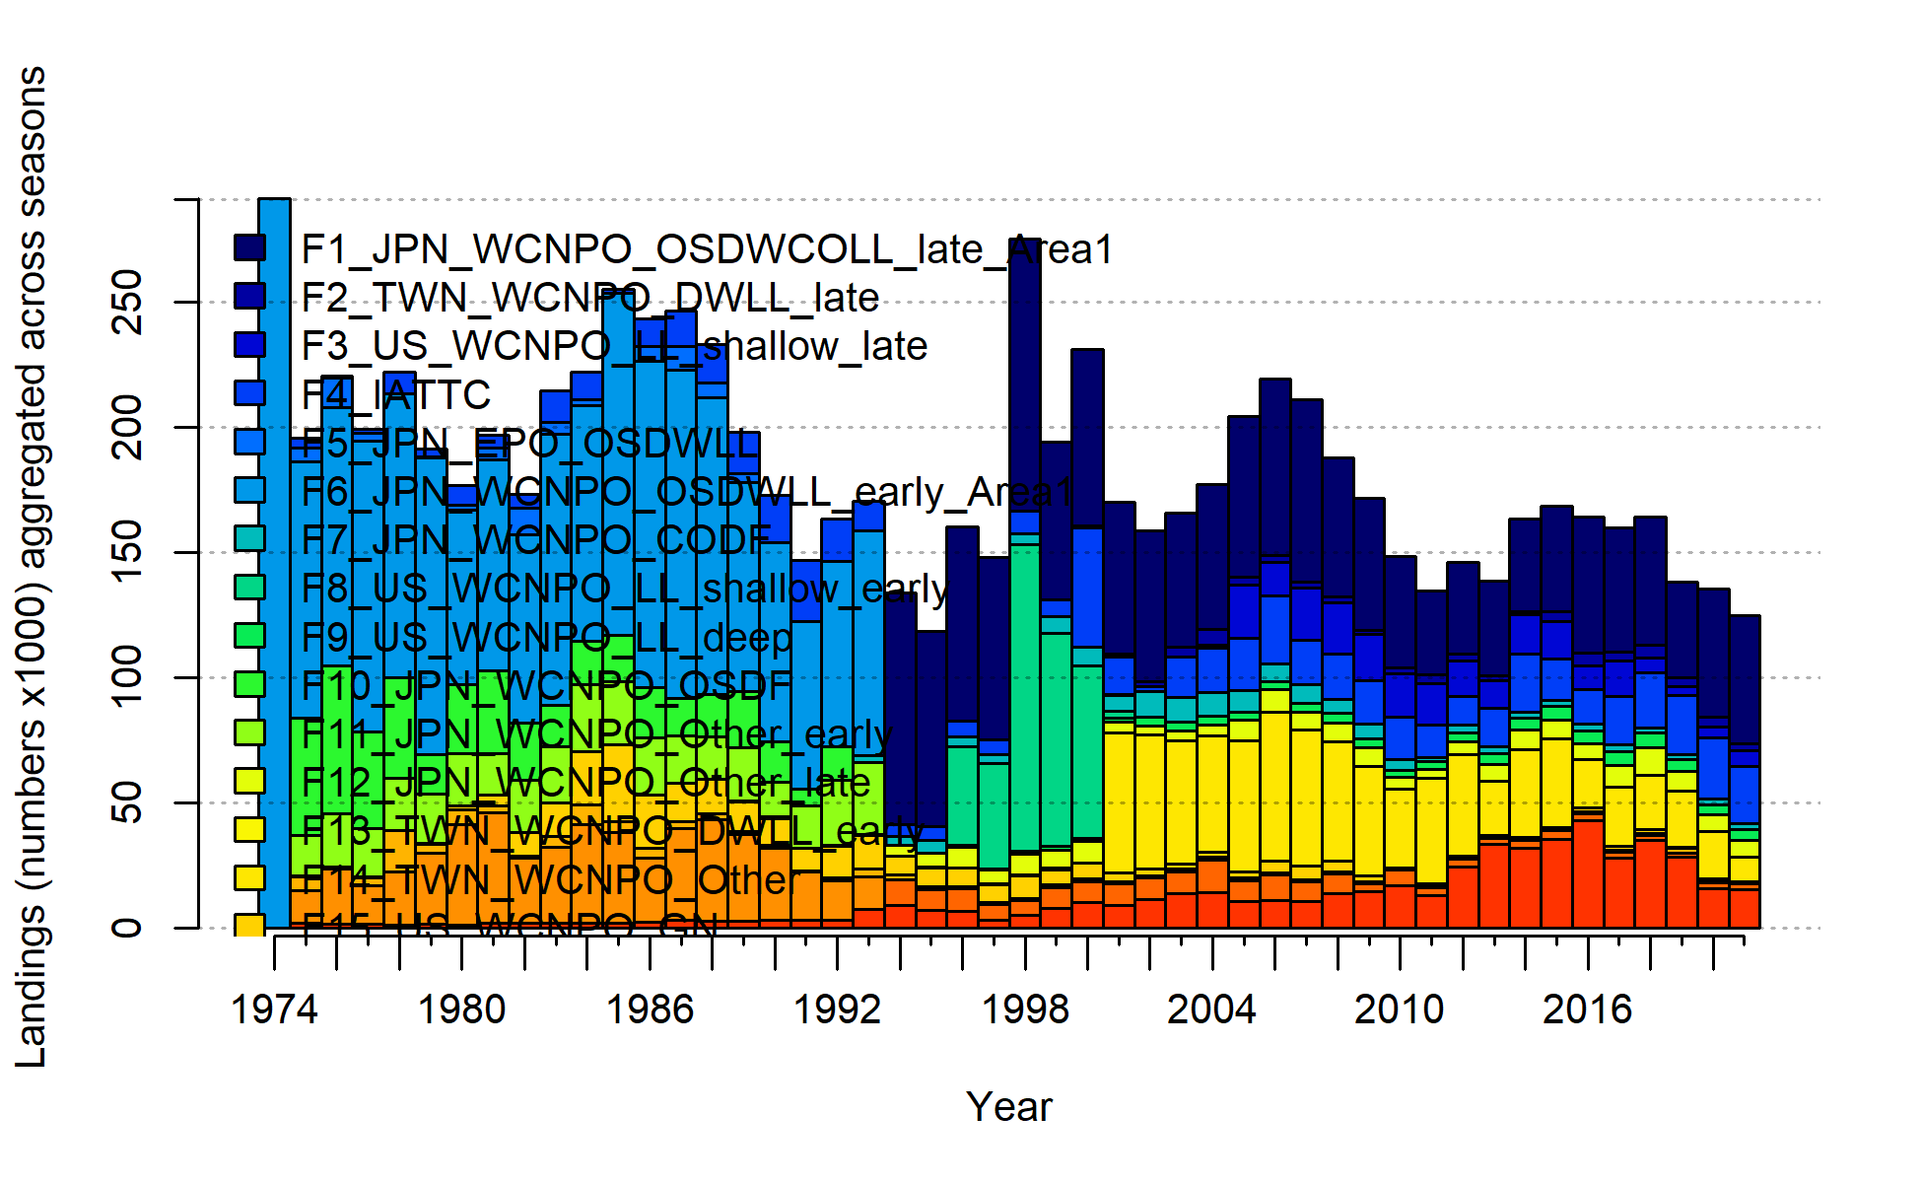
Initial equilibrium catch estimate
Equ. Catch likelihood issue solved. Bug in the source code. A fix will be released in the next SS version, current work around is to set Q4 SE to 0.05 for fleets estimating equilibrium catch

Slide 16


Slide 17
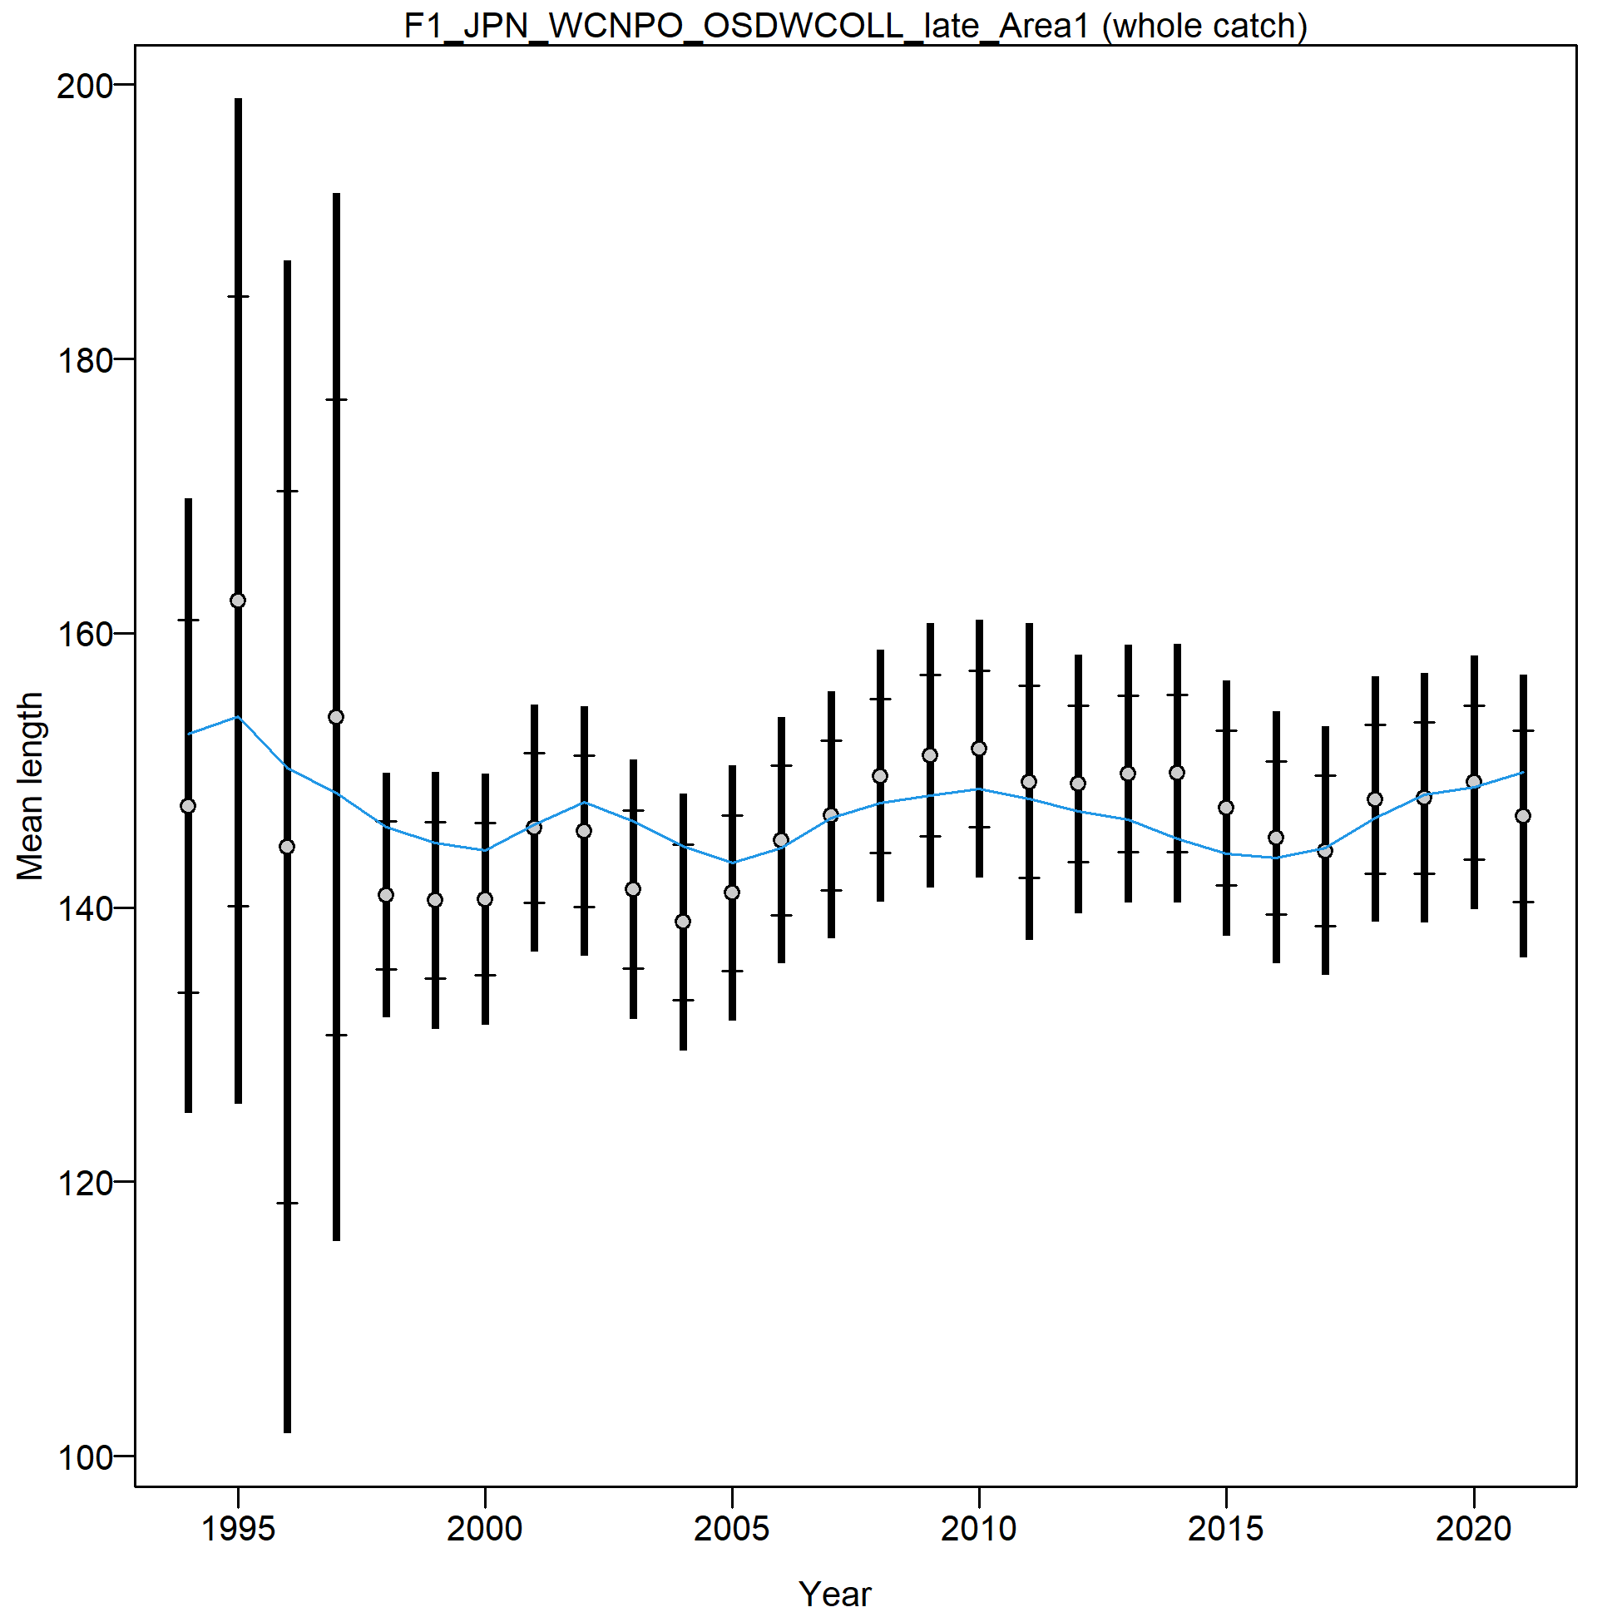
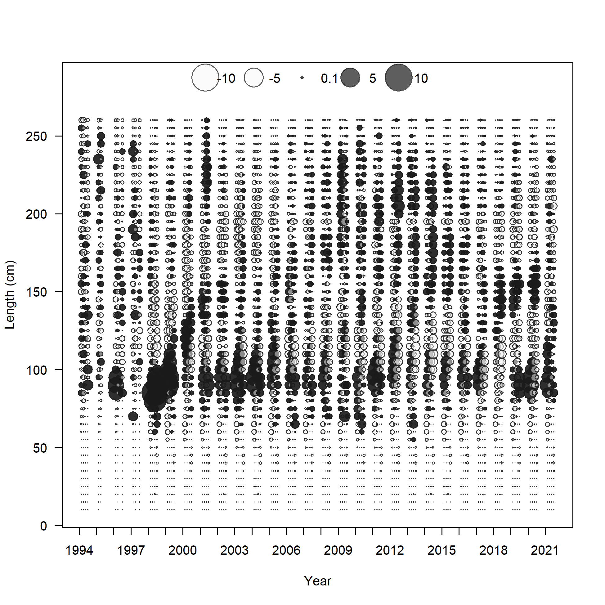
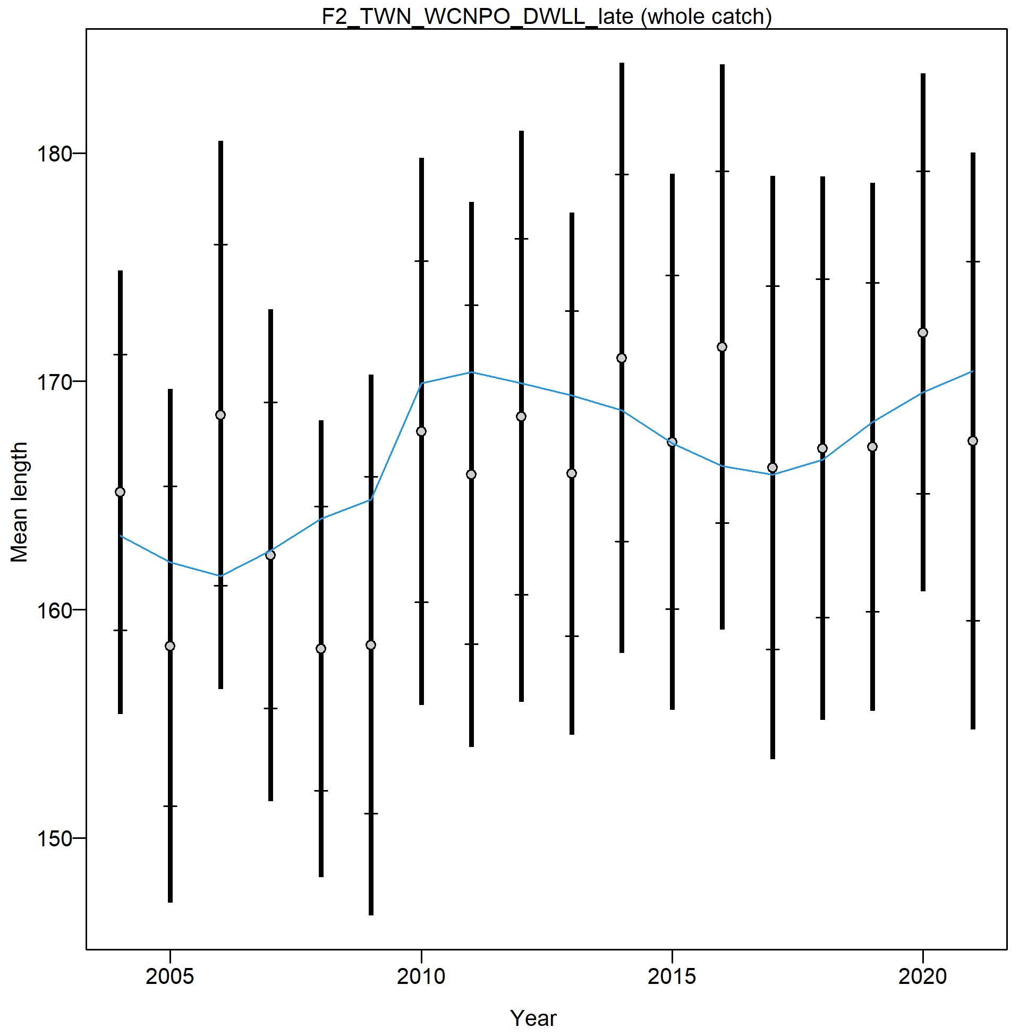
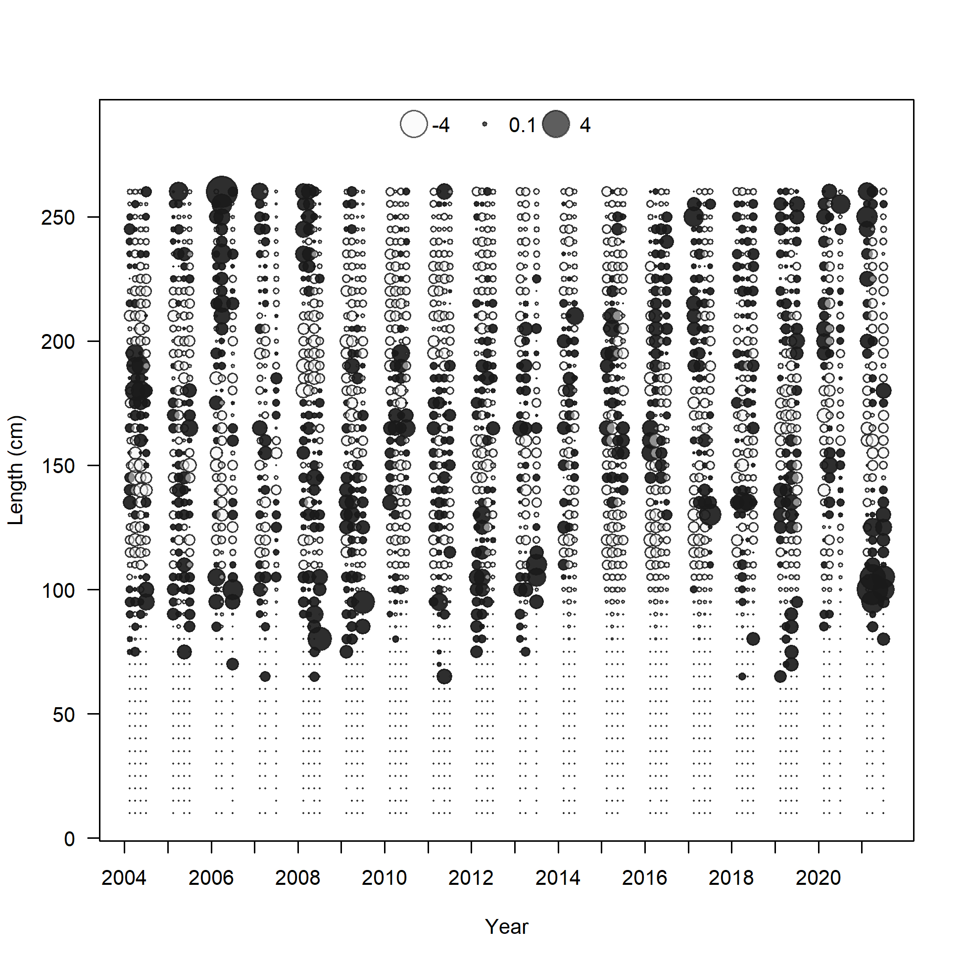
Block on JPN 1995 - 1998
Block on TWN 2004 – 2009

Slide 18
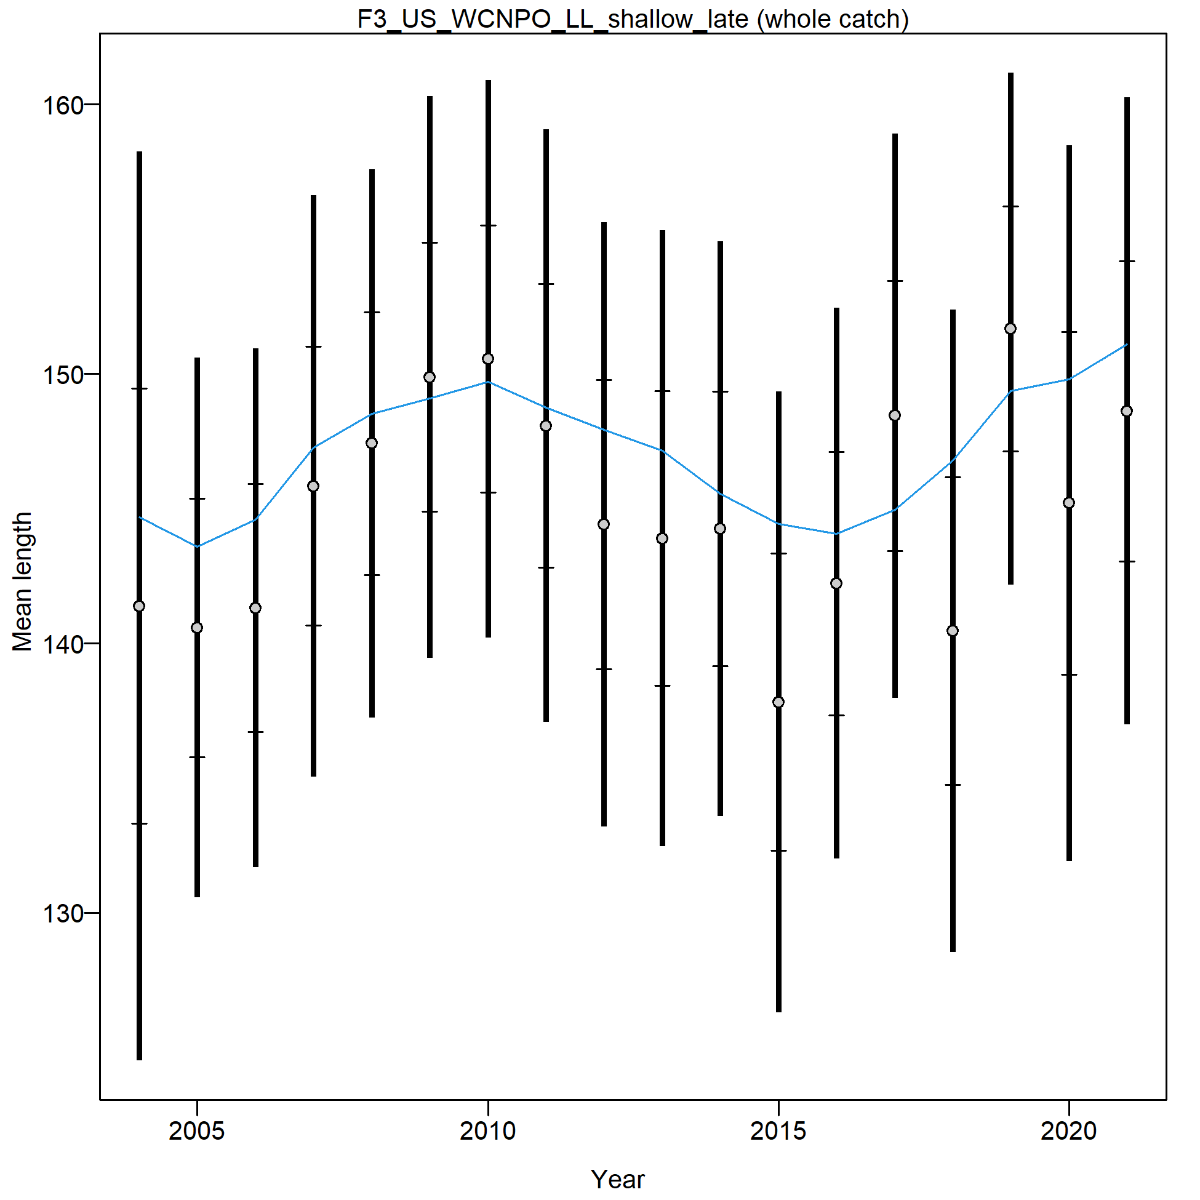
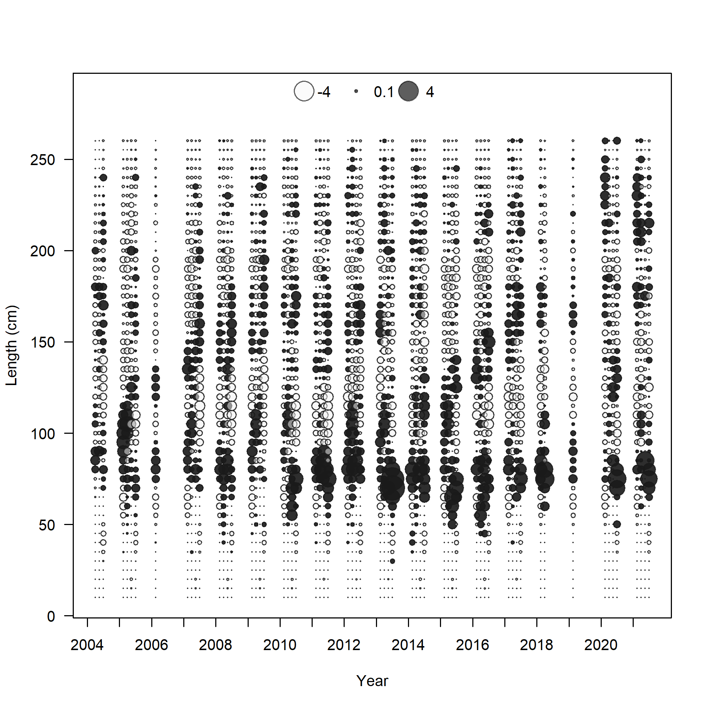
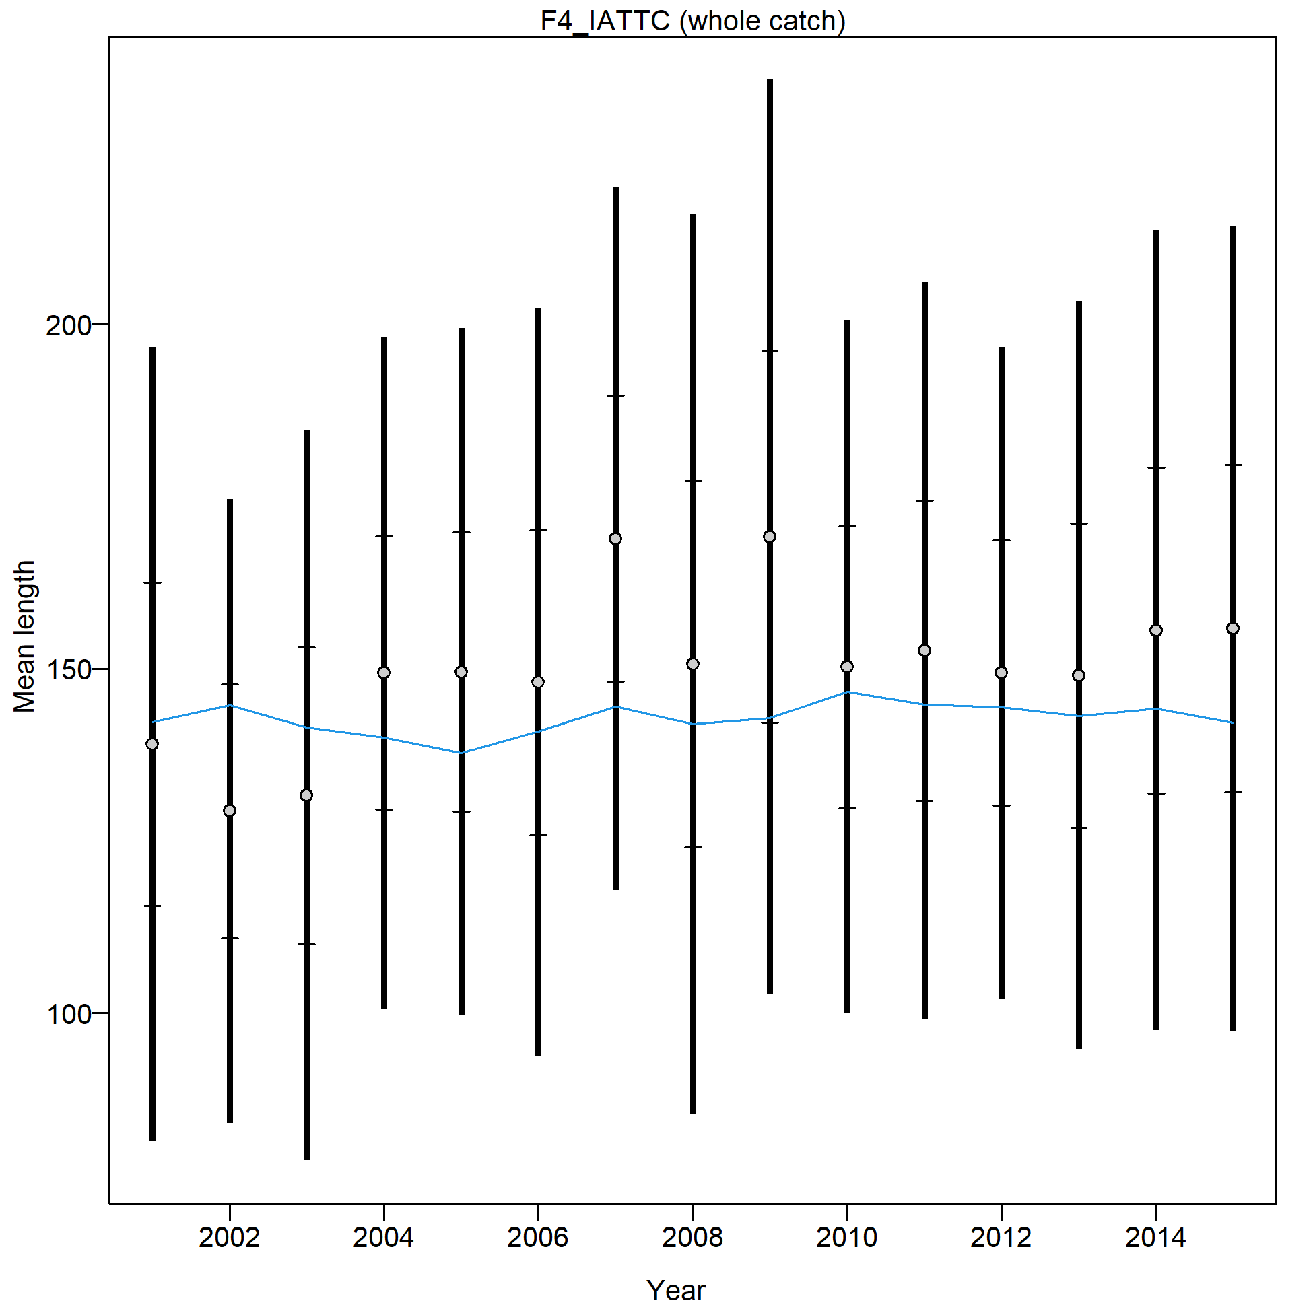
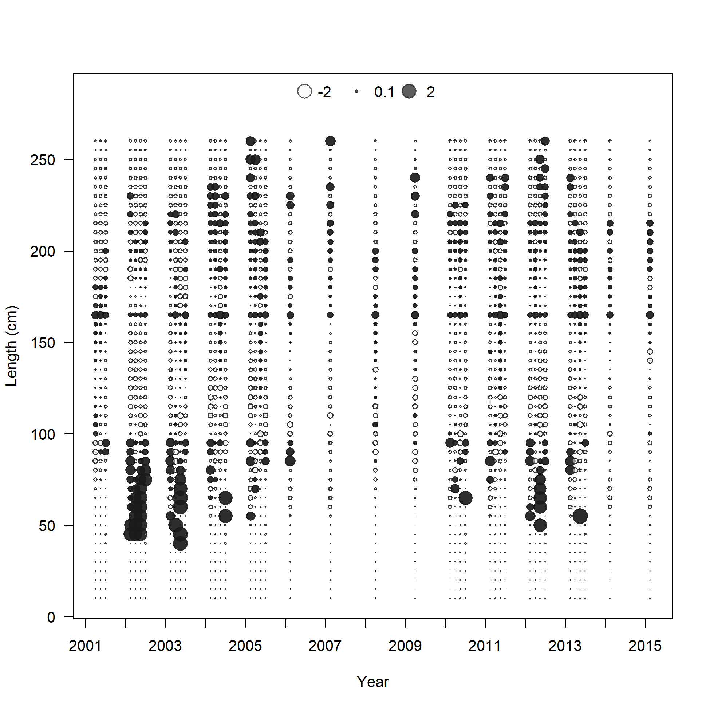
Dropped size comp prior to 2001 (1981, 1989)

Slide 19
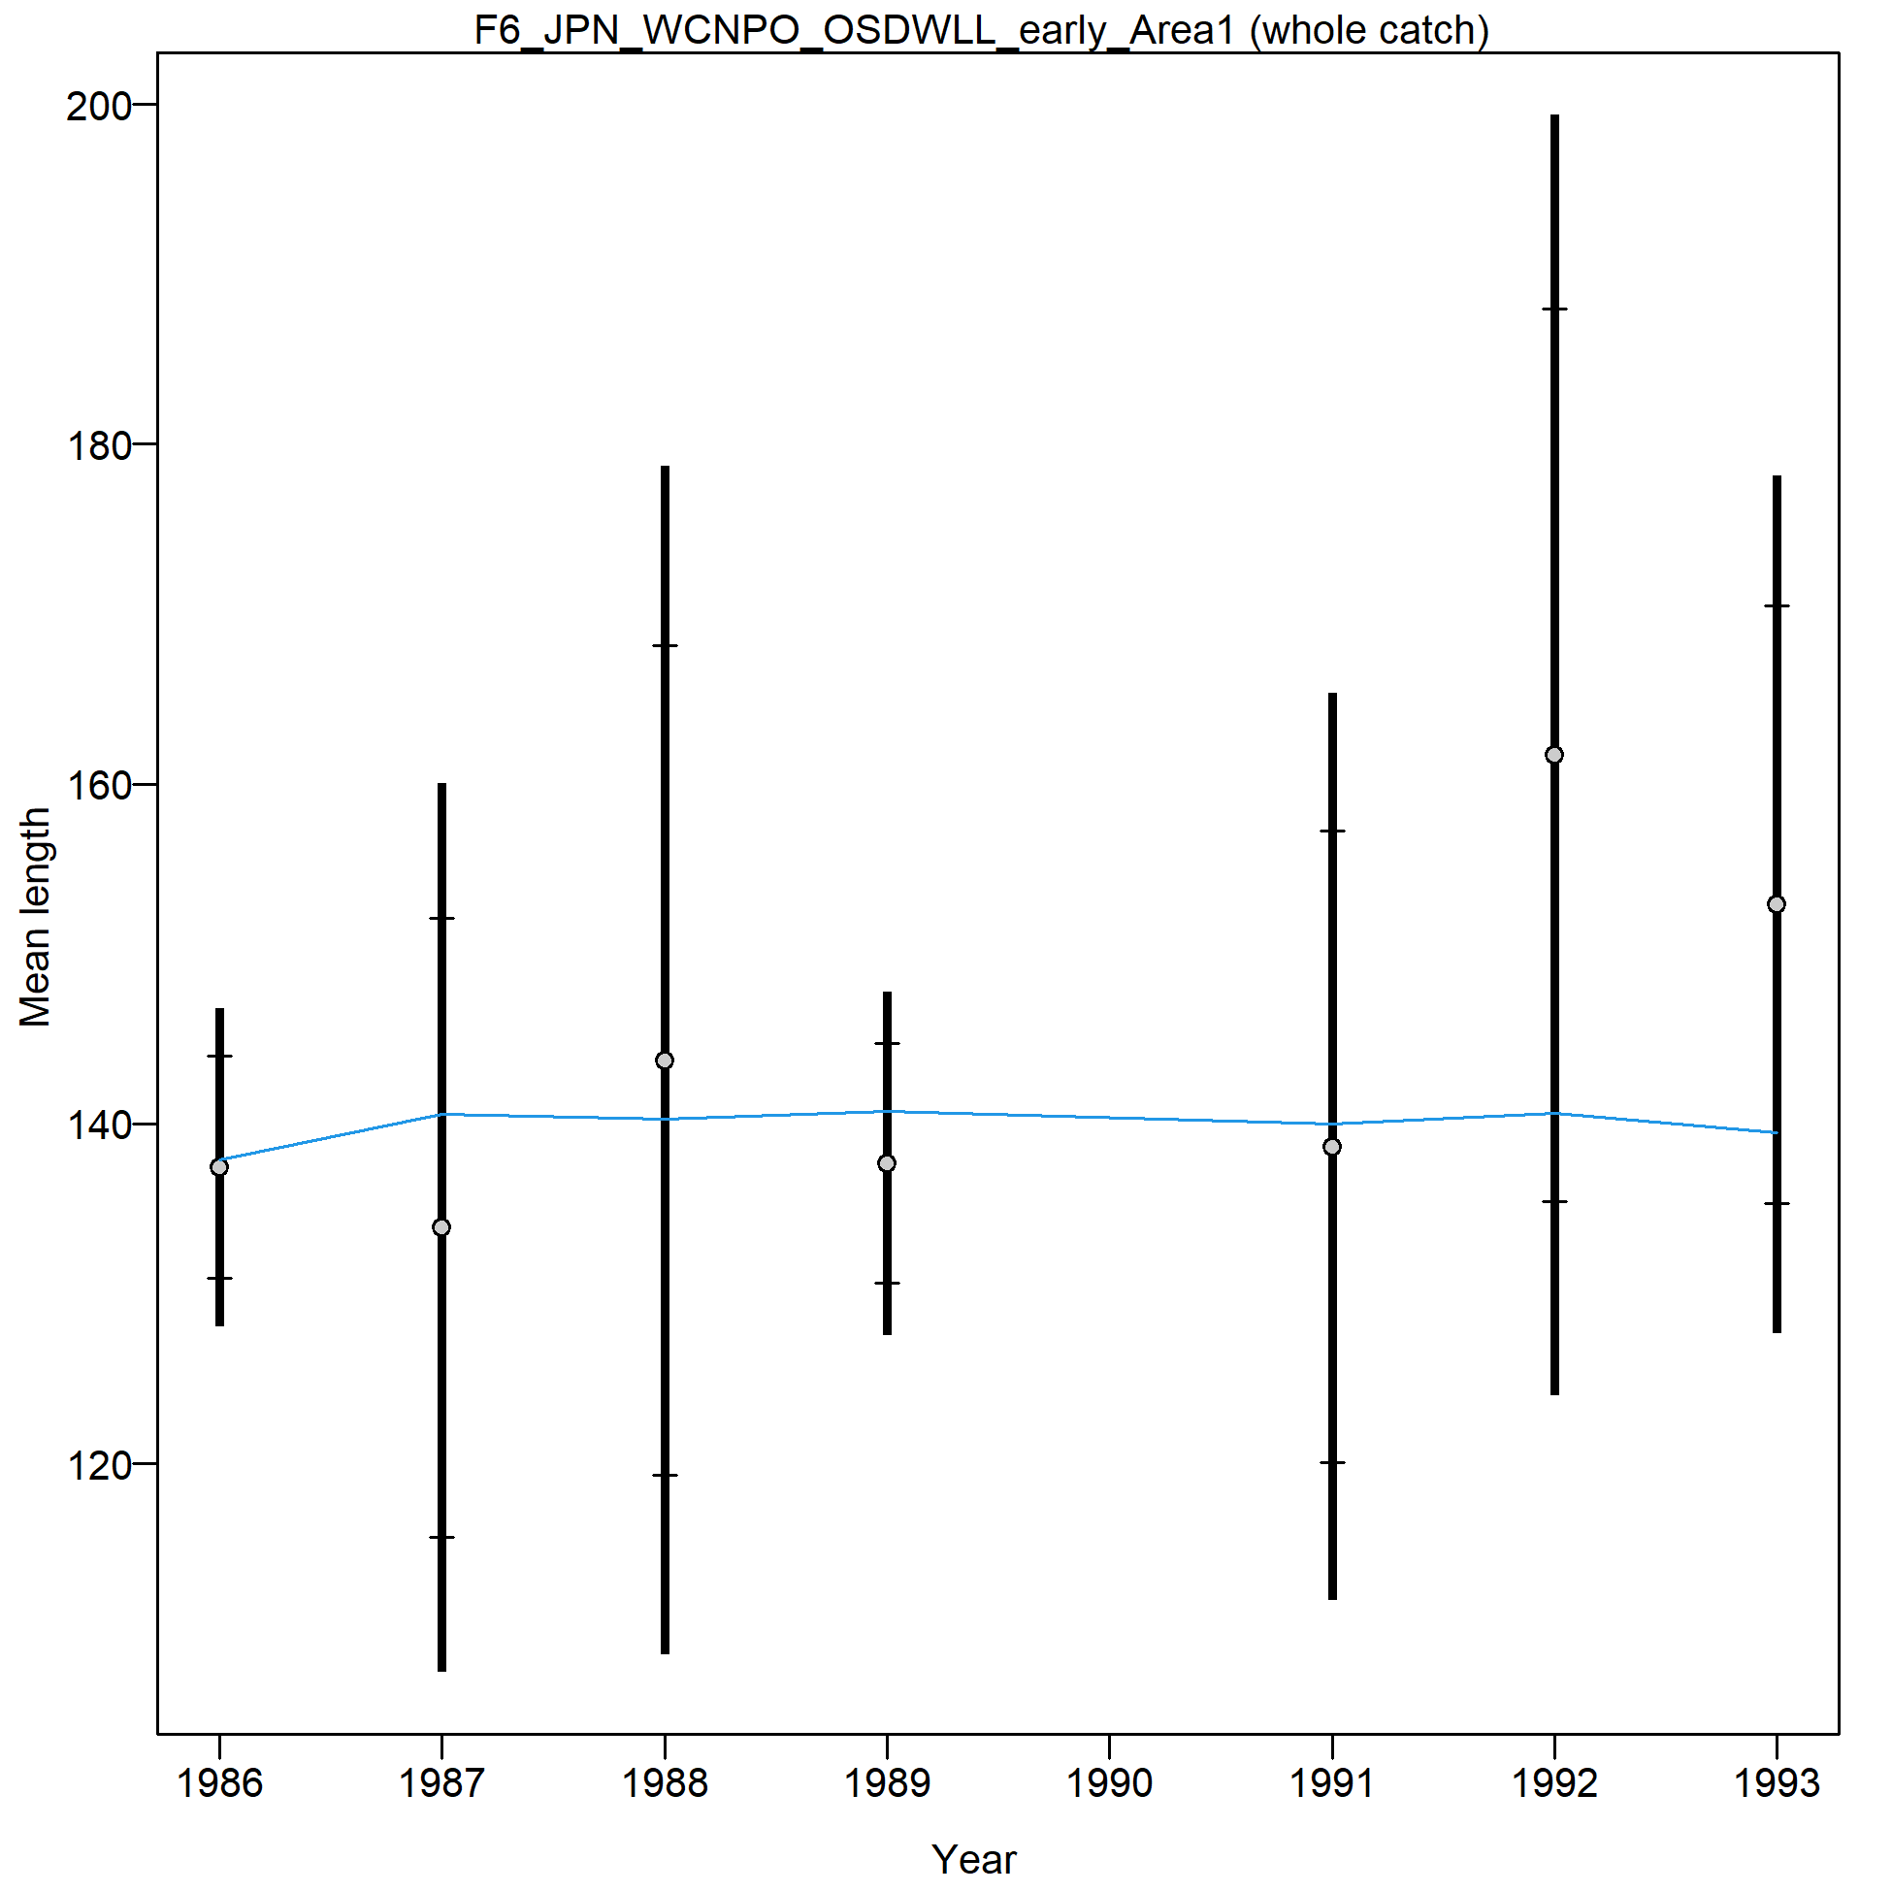
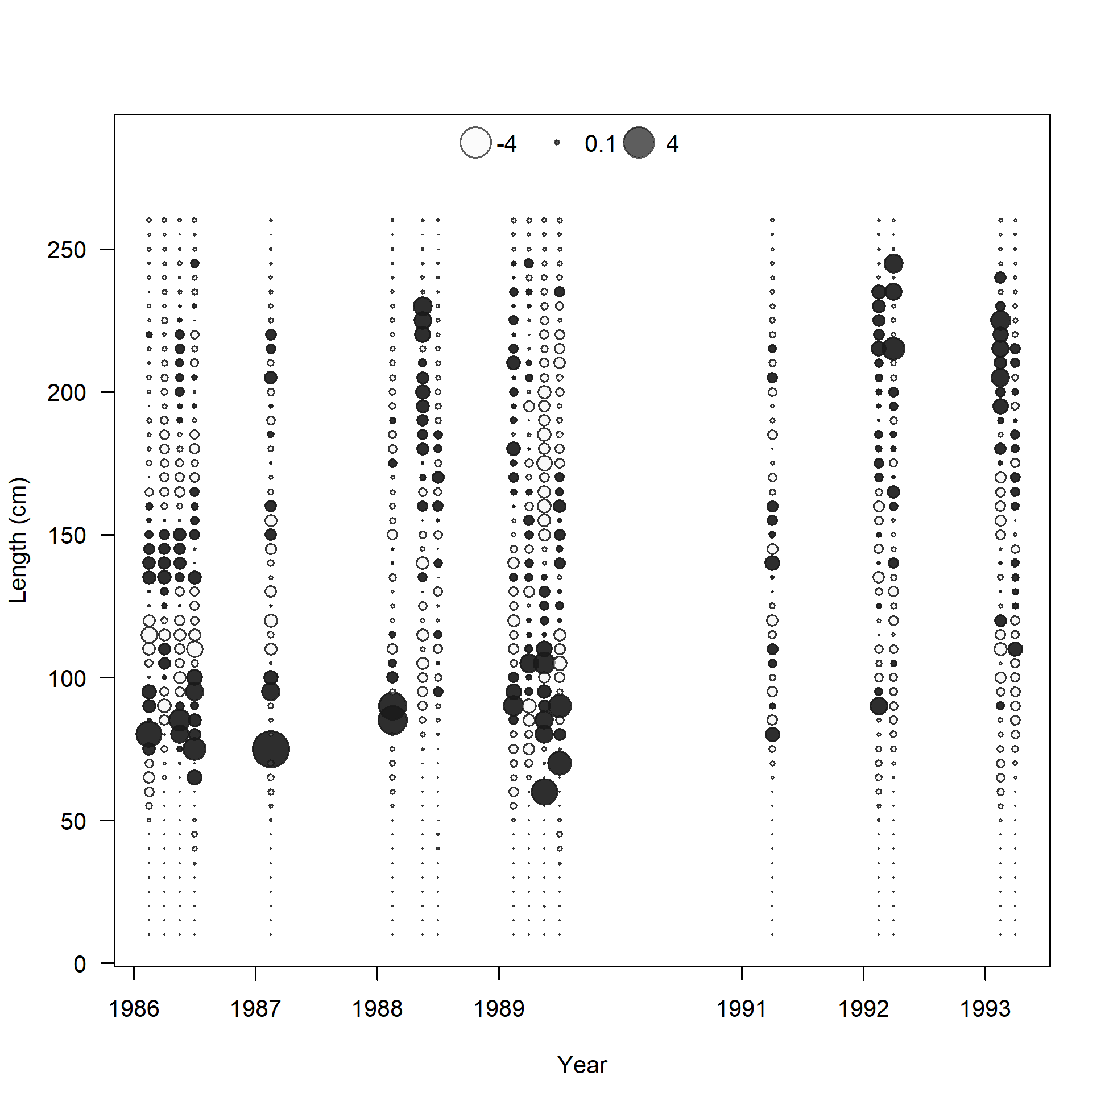
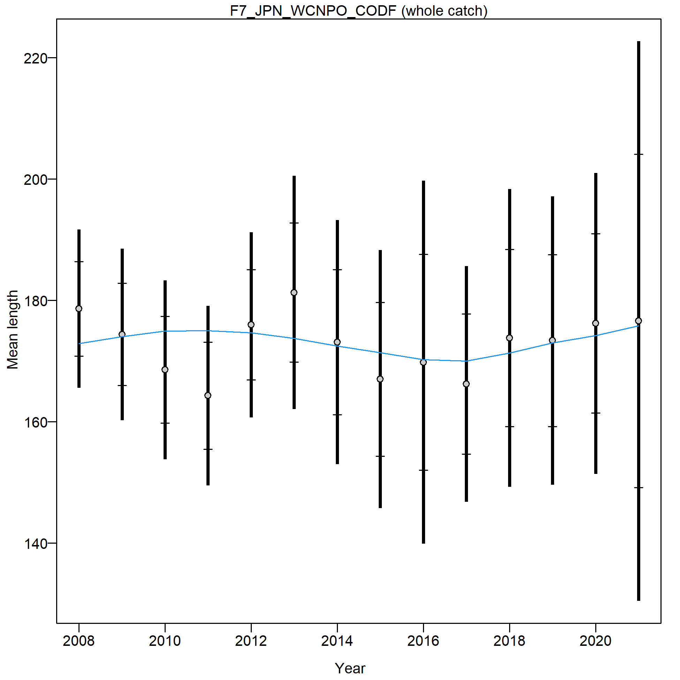
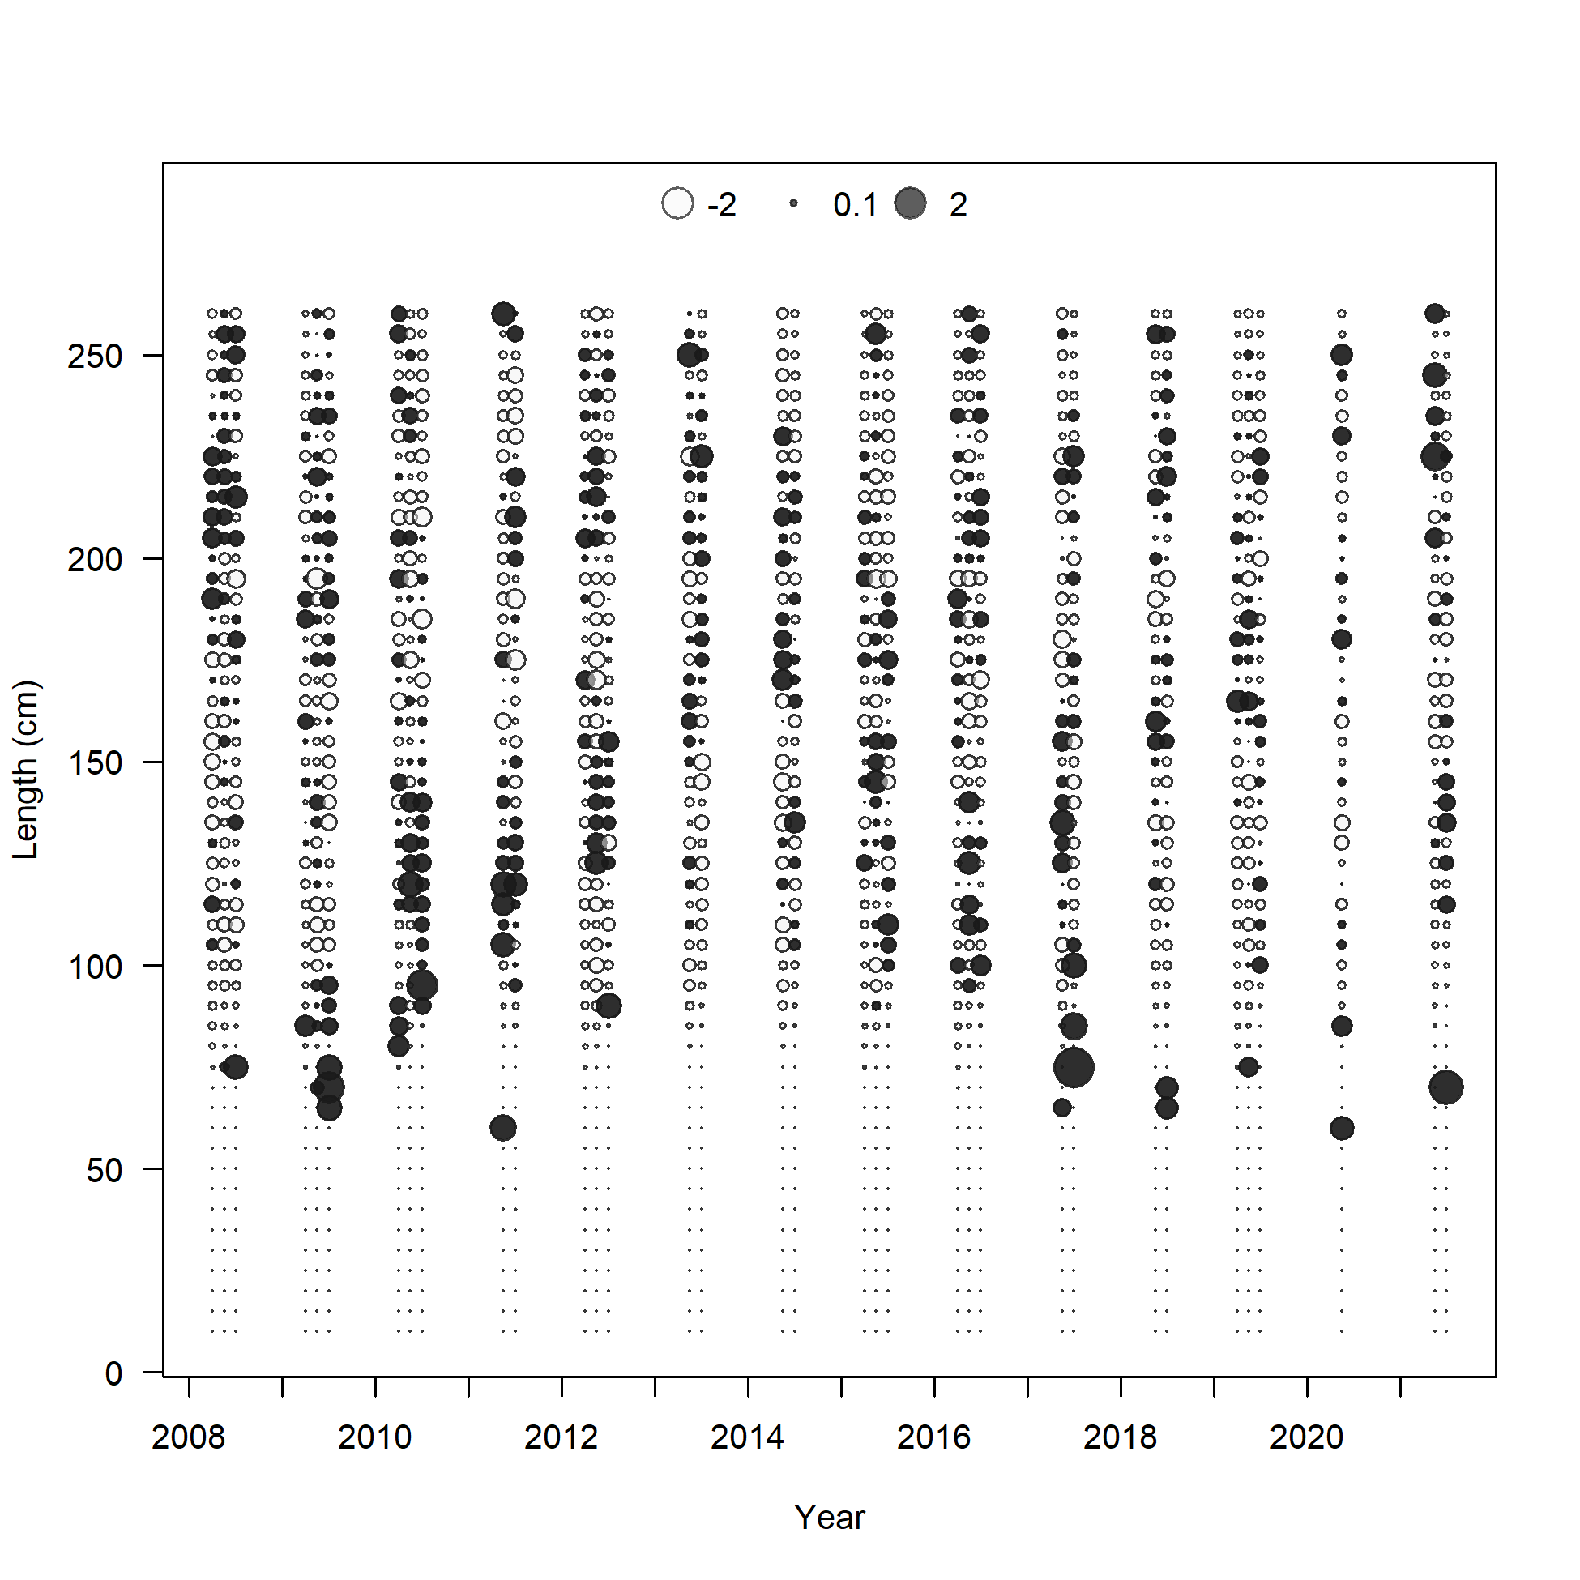

Slide 20
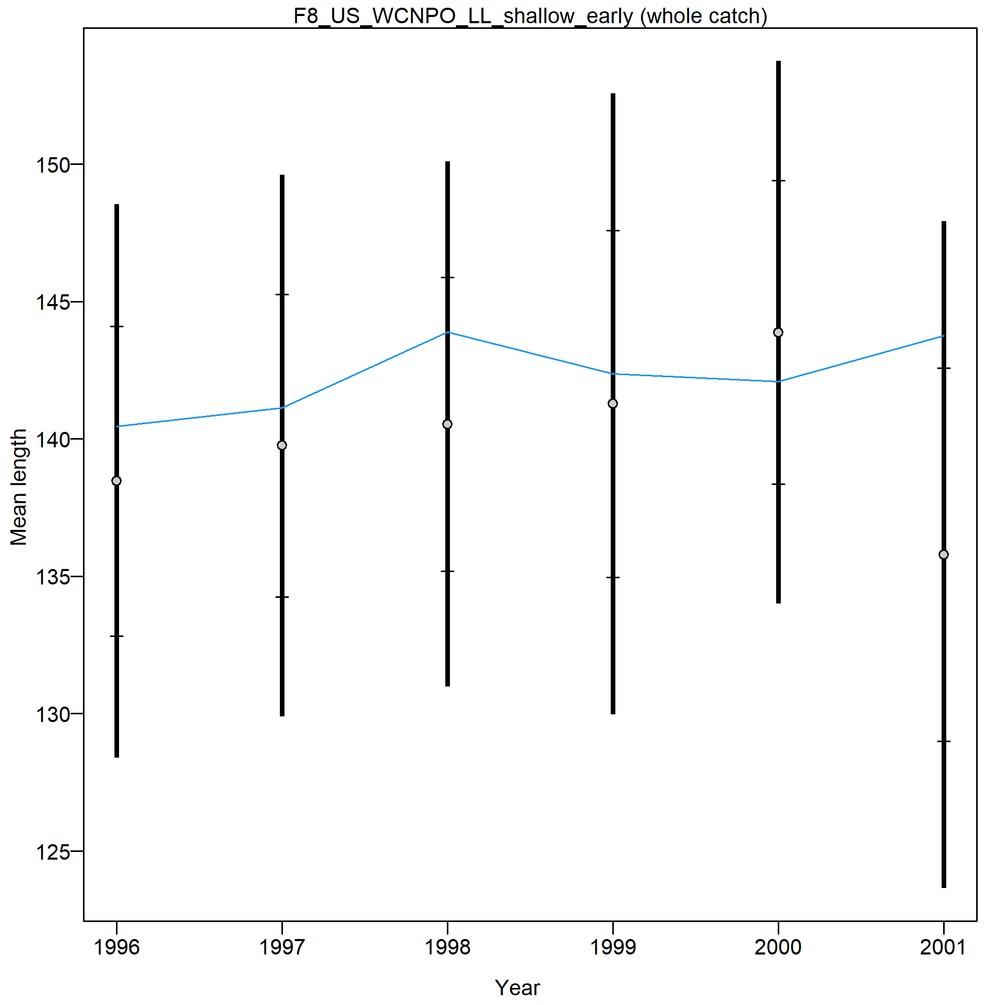
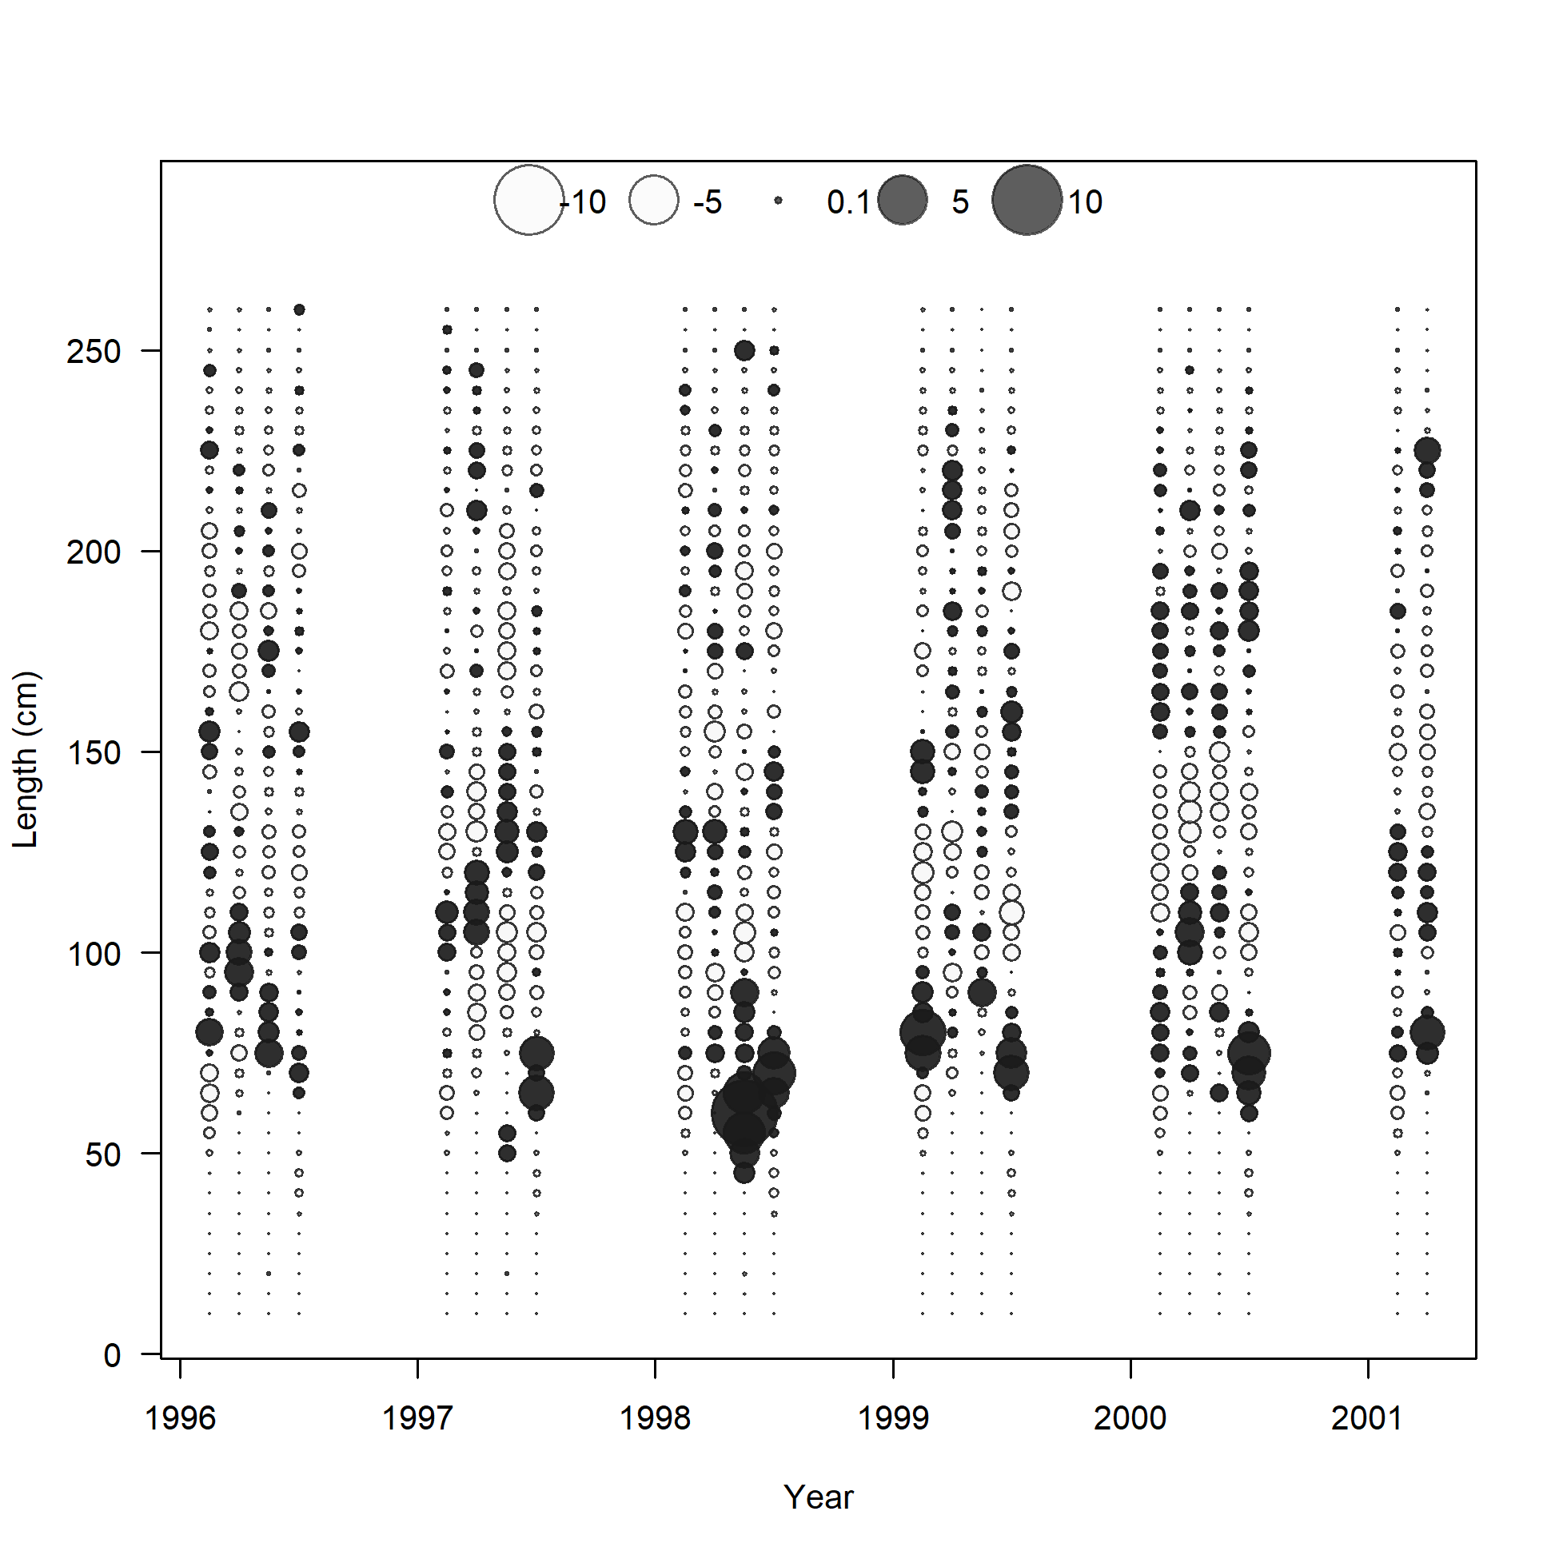
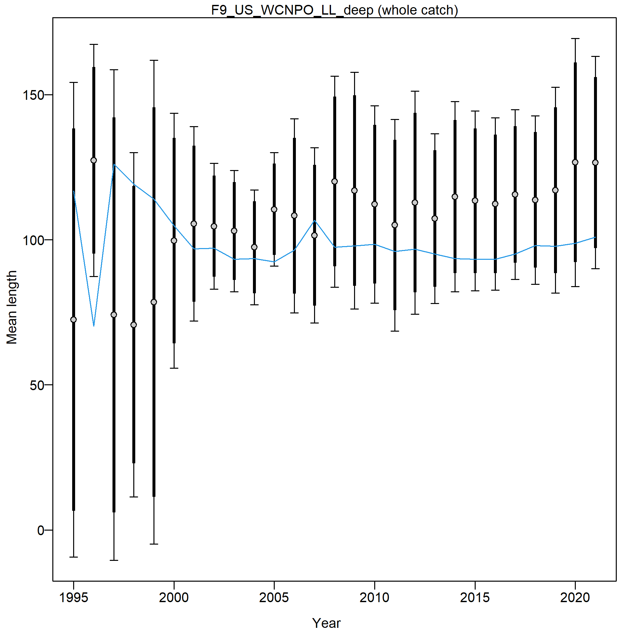
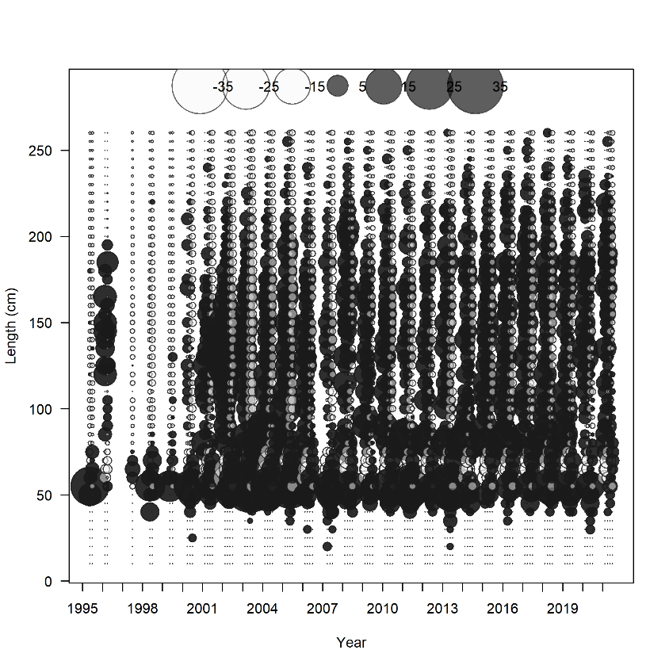
May need to separate into a quarterly fleet like JPN DF in MLS

Slide 21
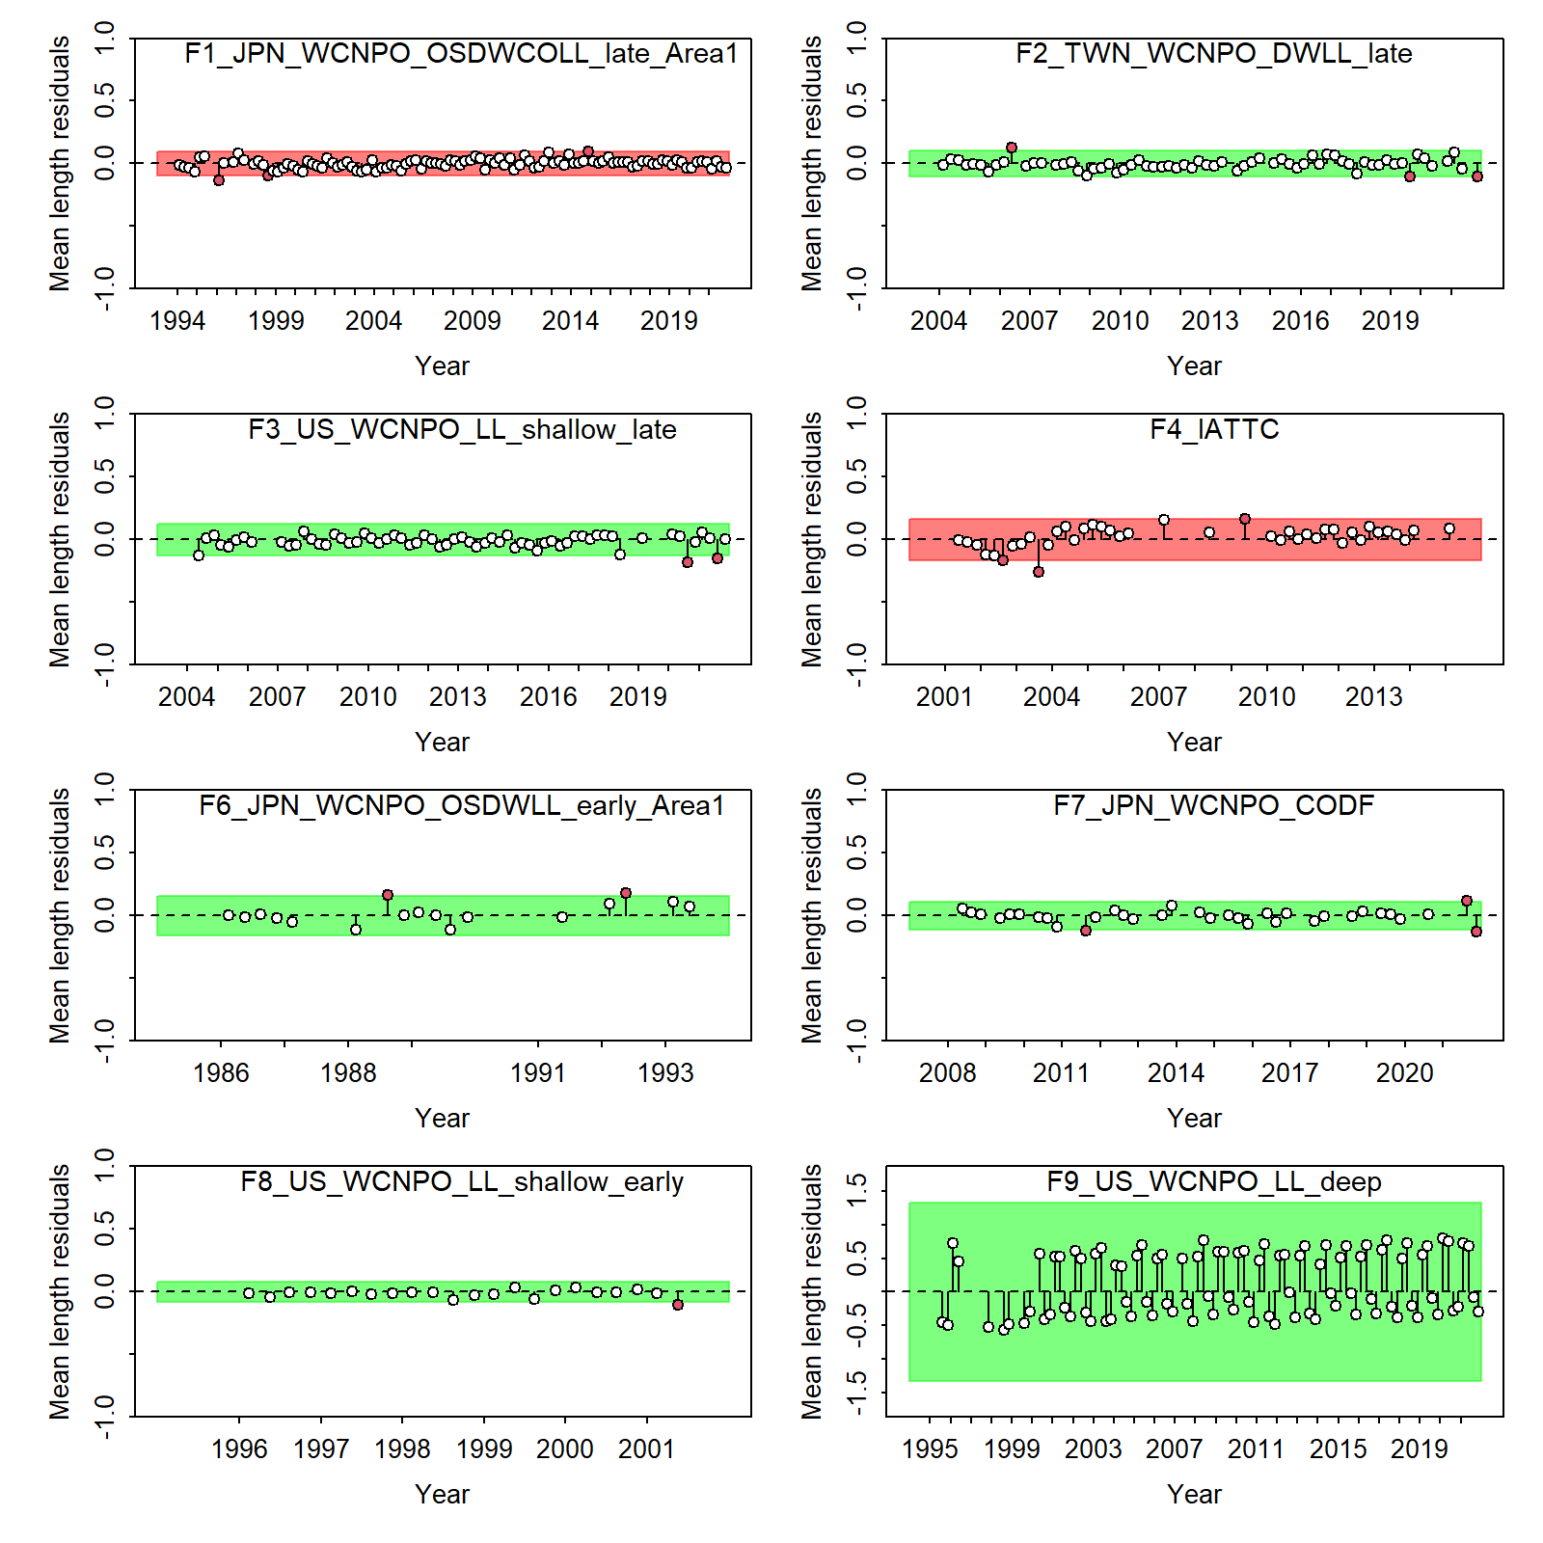

Slide 22

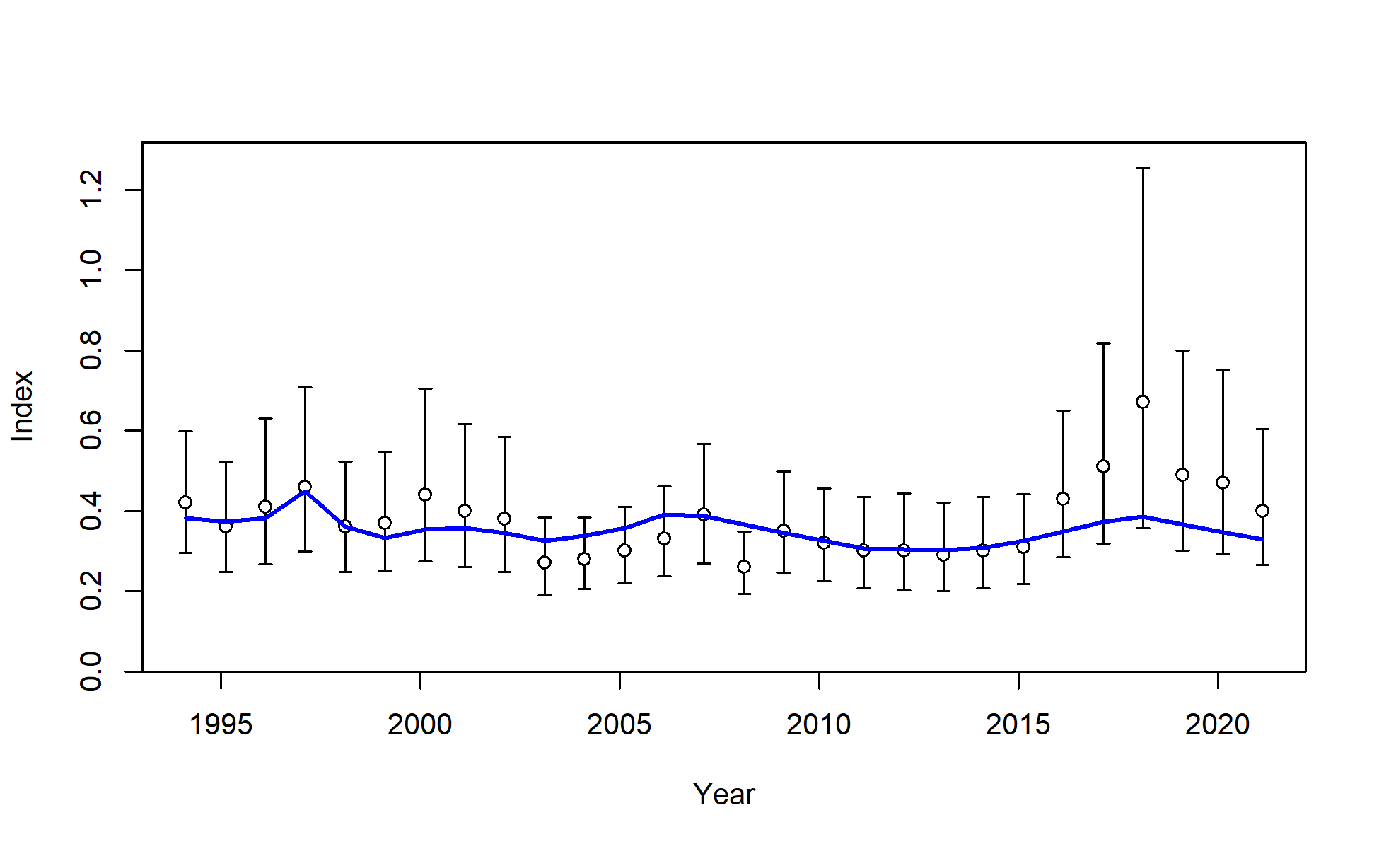
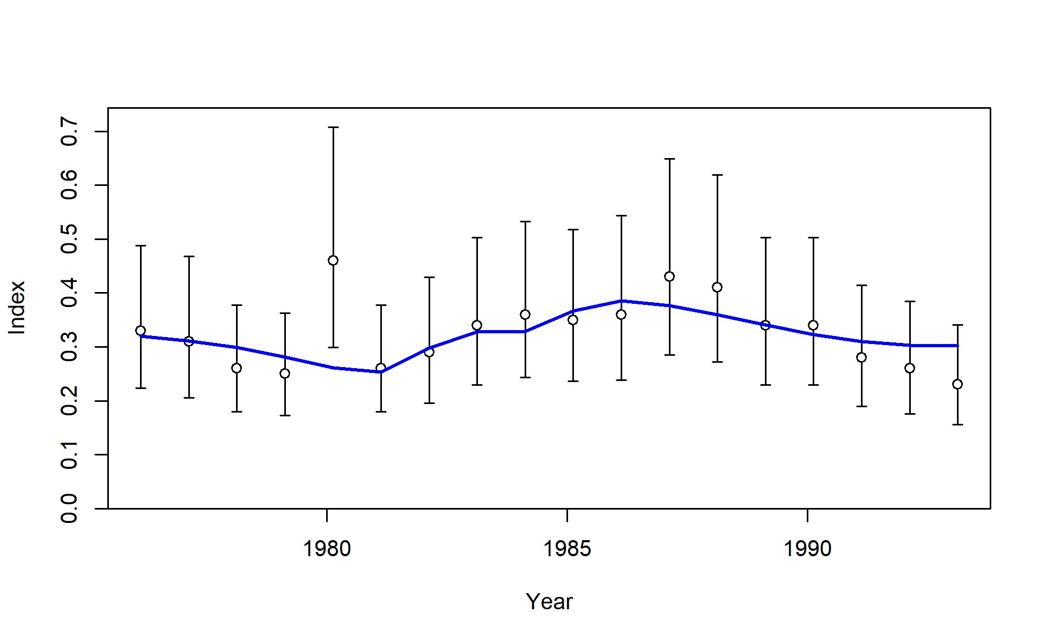
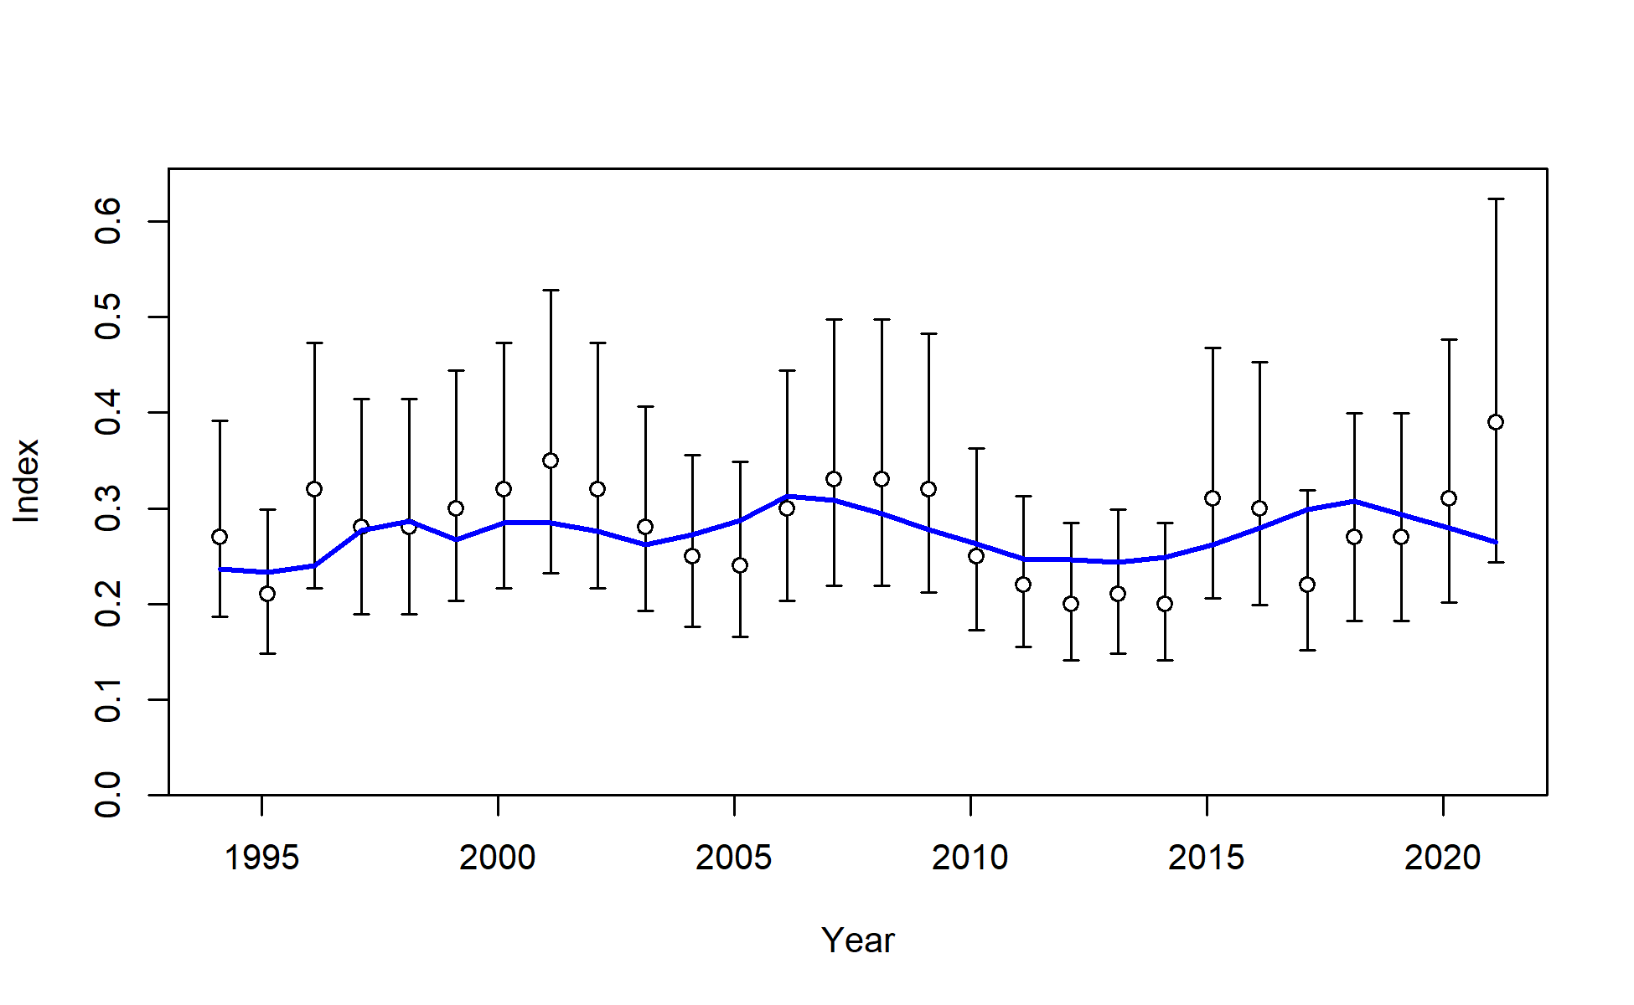
S1_JPN_WCNPO_OSDWLL_Early_Area1
S2_JPN_WCNPO_OSDWLL_Late_Area1
S3_JPN_WCNPO_OSDWLL_Early_Area2
S4_JPN_WCNPO_OSDWLL_Late_Area2

Slide 23
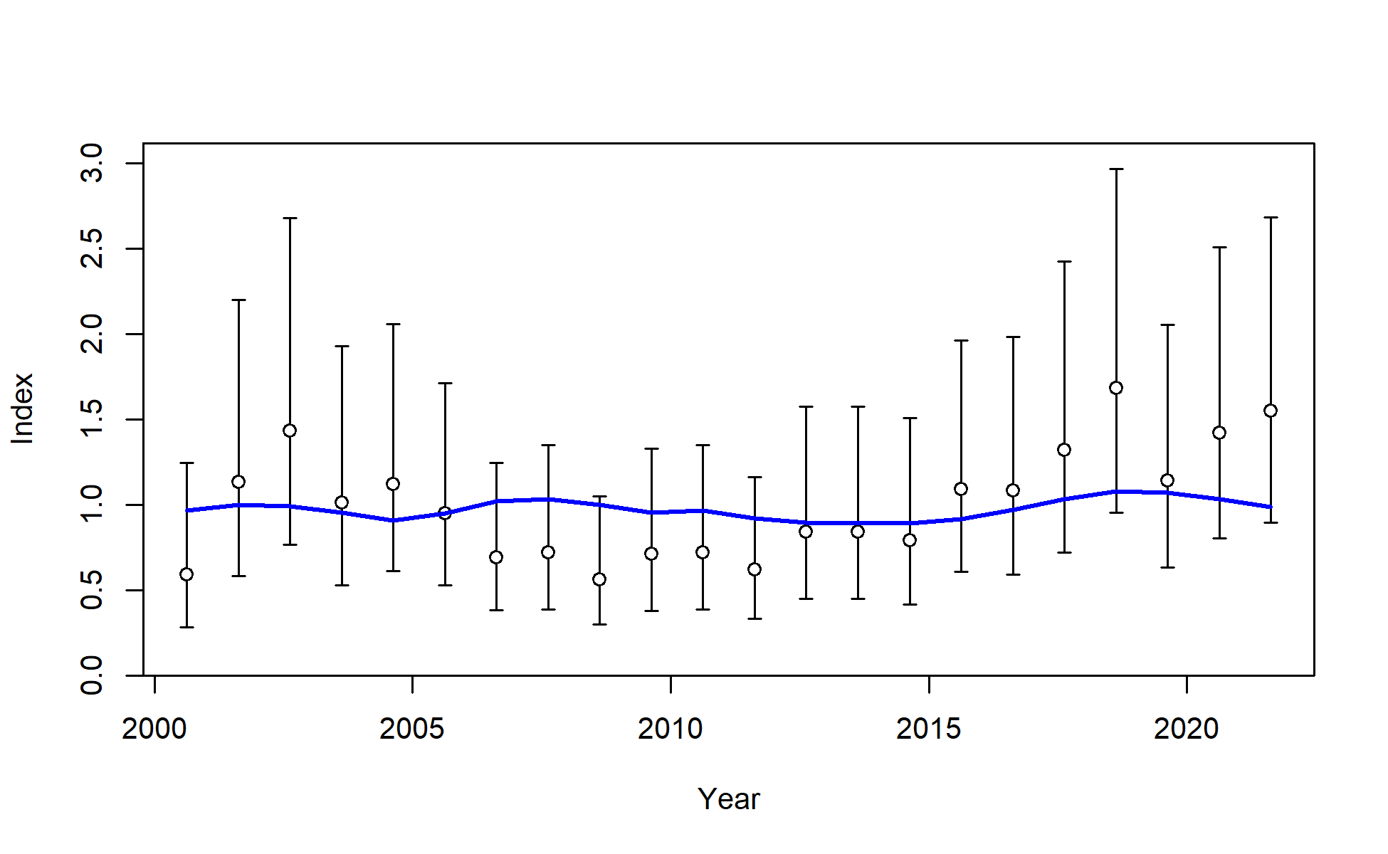

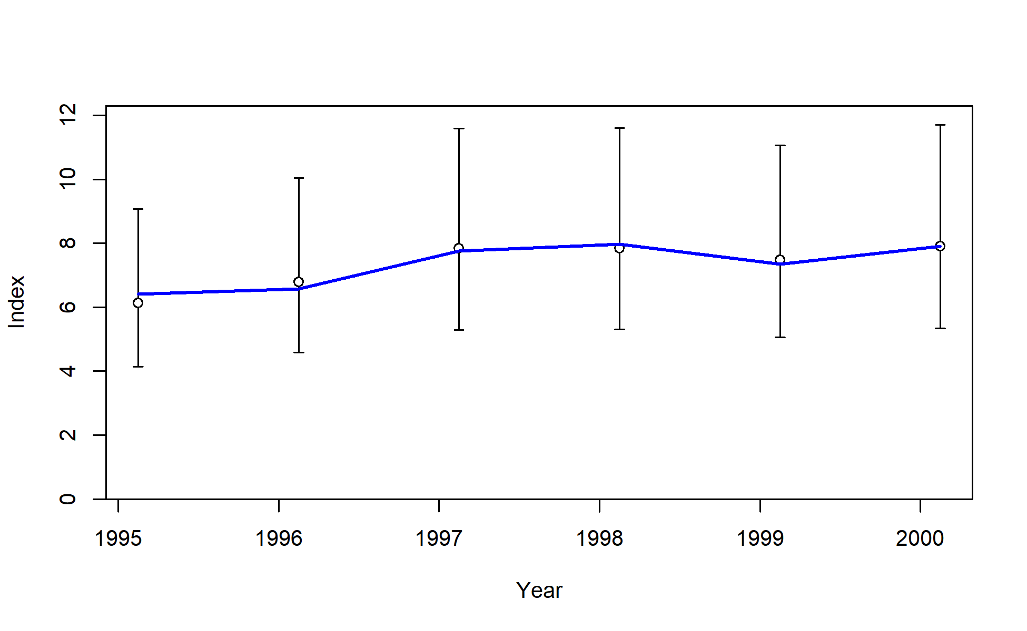
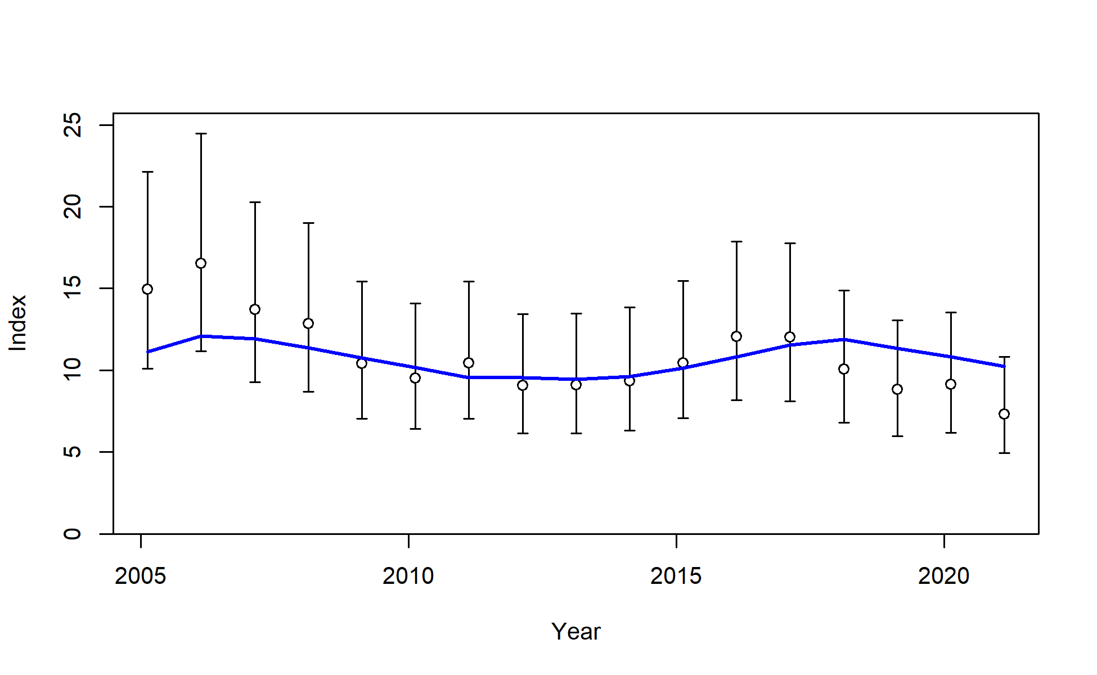
S5_TWN_WCNPO_DWLL_Late
S6_US_WCNPO_LL_deep (recruitment index)
S7_US_WCNPO_LL_shallow_early
S8_US_WCNPO_LL_shallow_late

Slide 24
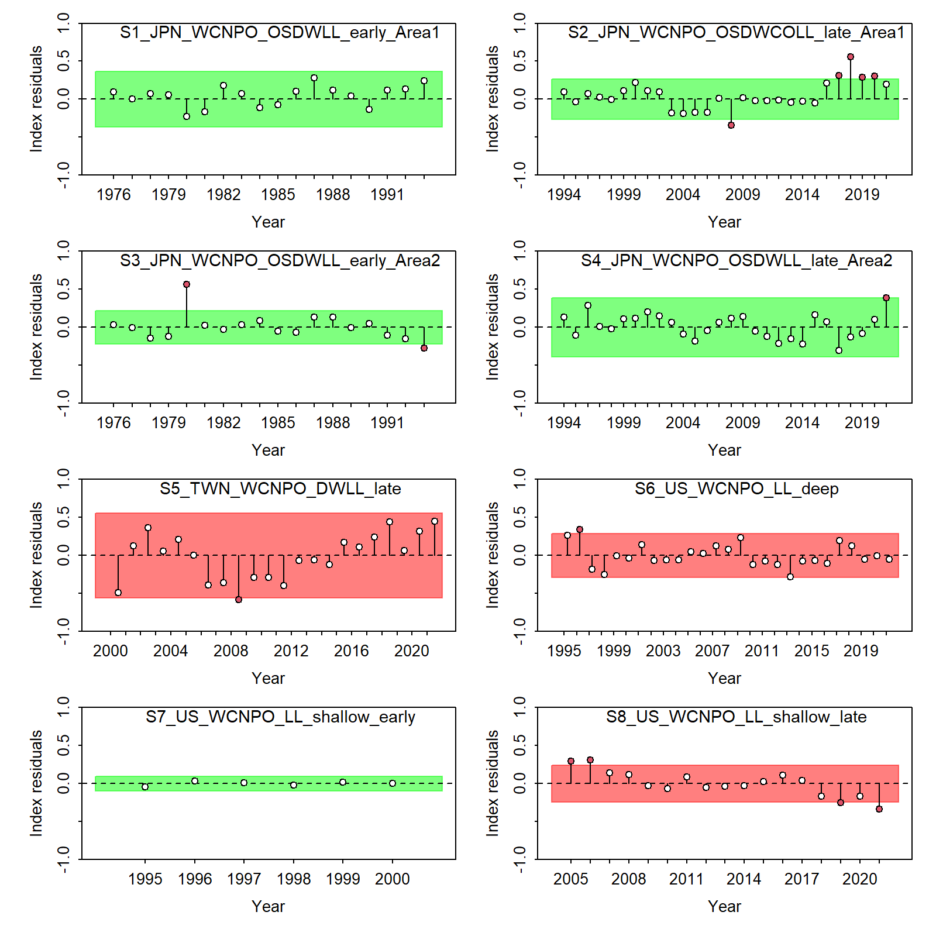

Slide 25
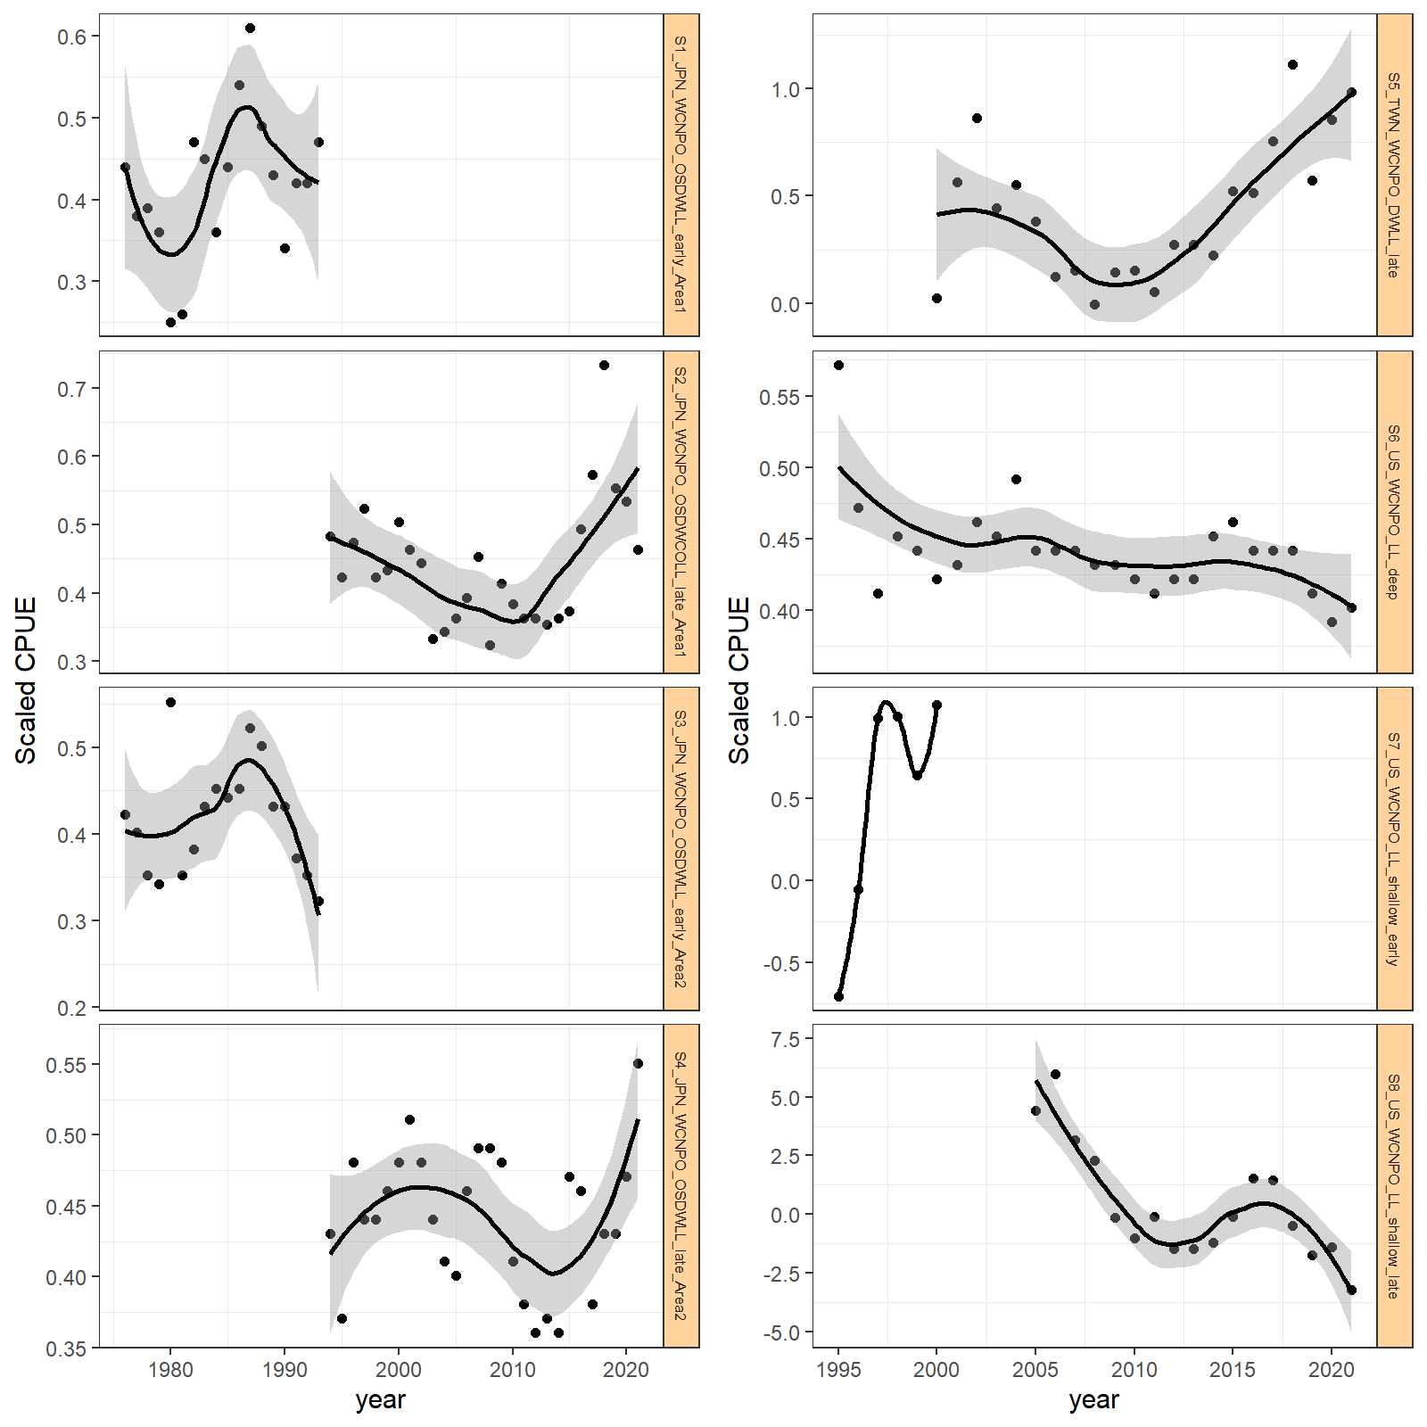

Not enough data in timeseries

Slide 26


Slide 27


Rescaled sigmaR to 0.42

Slide 28

SR_LN.R0. | TOTAL | Recruitment | Length_comp | Survey
6.2 | 184.99 | 92.9397 | 72.11 | 20.474
6.3 | 117.95 | 67.2598 | 37.18 | 14
6.4 | 81.43 | 39.5395 | 30.94 | 11.461
6.5 | 47.81 | 17.22485 | 22.64 | 8.454
6.6 | 18.66 | 4.3011 | 11.5 | 3.399
6.7 | 6.06 | 0.9395 | 5.48 | 0.206
6.8 | 2.1 | 0.1424 | 2.52 | 0
6.9 | 0.6 | 0.0007 | 0.93 | 0.231
7 | 0.07 | 0 | 0.25 | 0.391
7.1 | 0 | 0.0544 | 0 | 0.51
7.2 | 0.14 | 0.1082 | 0.01 | 0.585
7.25675 | 0.53 | 0.1789 | 0.35 | 0.569
7.3 | 0.54 | 0.1935 | 0.31 | 0.602
7.4 | 0.65 | 0.225 | 0.32 | 0.678
7.5 | 0.84 | 0.2544 | 0.4 | 0.751
7.6 | 1.08 | 0.2818 | 0.54 | 0.82
7.7 | 1.33 | 0.3074 | 0.7 | 0.881
7.8 | 1.58 | 0.3302 | 0.88 | 0.941
7.9 | 1.83 | 0.3513 | 1.05 | 0.995
8 | 2.08 | 0.3714 | 1.23 | 1.044

Slide 29

SR_LN.R0 | ALL | S1 | S2 | S3 | S4 | S5 | S6 | S7 | S8
6.2 | 20.474 | 4.5446 | 3.4276 | 1.4622 | 2.4174 | 3.2729 | 8.9667 | 0.26109 | 0
6.3 | 14 | 2.3605 | 2.5718 | 2.0139 | 1.7409 | 2.6885 | 5.7707 | 0.20894 | 0.5235
6.4 | 11.461 | 2.3815 | 2.2113 | 1.4021 | 1.4768 | 2.3864 | 4.5154 | 0.17682 | 0.7892
6.5 | 8.454 | 1.8242 | 1.8037 | 0.6707 | 1.3882 | 2.0959 | 3.32 | 0.16224 | 1.0674
6.6 | 3.399 | 0.8447 | 0.9959 | 0 | 1.0268 | 1.4563 | 1.1991 | 0.11347 | 1.6417
6.7 | 0.206 | 0.1067 | 0.1811 | 0.3532 | 0.7105 | 0.2566 | 0 | 0.05737 | 2.4188
6.8 | 0 | 0 | 0 | 0.6166 | 0.632 | 0 | 0.091 | 0.03234 | 2.5069
6.9 | 0.231 | 0.0294 | 0.0627 | 0.675 | 0.5703 | 0.1392 | 0.2994 | 0.01796 | 2.3153
7 | 0.391 | 0.0782 | 0.1523 | 0.6722 | 0.5008 | 0.2655 | 0.47 | 0.00938 | 2.1218
7.1 | 0.51 | 0.1194 | 0.2545 | 0.6455 | 0.4368 | 0.3778 | 0.6072 | 0.00399 | 1.9433
7.2 | 0.585 | 0.1546 | 0.3687 | 0.6023 | 0.3487 | 0.4733 | 0.7196 | 0.0021 | 1.7941
7.25675 | 0.569 | 0.1746 | 0.4416 | 0.5714 | 0.2292 | 0.5481 | 0.7888 | 0.00024 | 1.6932
7.3 | 0.602 | 0.1904 | 0.4833 | 0.5576 | 0.2032 | 0.5762 | 0.8232 | 8.00E-05 | 1.6463
7.4 | 0.678 | 0.2238 | 0.5729 | 0.5284 | 0.1549 | 0.6353 | 0.8919 | 0 | 1.5492
7.5 | 0.751 | 0.2533 | 0.6542 | 0.5027 | 0.1168 | 0.6878 | 0.9488 | 0.0002 | 1.4656
7.6 | 0.82 | 0.2795 | 0.7283 | 0.4802 | 0.0854 | 0.7349 | 0.9968 | 0.00062 | 1.3925
7.7 | 0.881 | 0.3027 | 0.7956 | 0.4601 | 0.0569 | 0.7781 | 1.0374 | 0.00117 | 1.3279
7.8 | 0.941 | 0.3235 | 0.8562 | 0.4427 | 0.0347 | 0.8161 | 1.0722 | 0.0018 | 1.272
7.9 | 0.995 | 0.3417 | 0.9108 | 0.4274 | 0.0159 | 0.8501 | 1.1022 | 0.00247 | 1.223
8 | 1.044 | 0.3571 | 0.9601 | 0.4138 | 0 | 0.8808 | 1.1283 | 0.00314 | 1.1799

Slide 30

SR_LN.R0 | ALL.2 | F1_JPN_WCNPO_OSDWCOLL_late_Area1 | F2_TWN_WCNPO_DWLL_late | F4_IATTC | F6_JPN_WCNPO_OSDWLL_early_Area1 | F8_US_WCNPO_LL_shallow_early | F9_US_WCNPO_LL_deep
6.2 | 72.11 | 4.66 | 5.9235 | 2.8955 | 19.7885 | 5.14015 | 35.4
6.3 | 37.18 | 1.4895 | 5.7975 | 2.7162 | 16.5948 | 2.9508 | 9.555
6.4 | 30.94 | 1.3715 | 5.2875 | 2.5085 | 10.2682 | 4.2392 | 9.25
6.5 | 22.64 | 1.0675 | 4.432 | 2.2369 | 4.358 | 3.9978 | 8.58
6.6 | 11.5 | 0.726 | 2.334 | 1.69515 | 0.3491 | 1.7601 | 6.665
6.7 | 5.48 | 0.3645 | 0.5025 | 1.30305 | 0 | 1.3065 | 3.78
6.8 | 2.52 | 0.126 | 0.1905 | 1.1764 | 0.12165 | 0.9734 | 1.61
6.9 | 0.93 | 0 | 0.03 | 1.1197 | 0.2203 | 0.73805 | 0.505
7 | 0.25 | 0.0025 | 0 | 1.06055 | 0.291 | 0.5648 | 0.075
7.1 | 0 | 0.0465 | 0.0265 | 0.99715 | 0.3422 | 0.4321 | 0
7.2 | 0.01 | 0.0875 | 0.0705 | 0.94135 | 0.3649 | 0.34655 | 0.16
7.25675 | 0.35 | 0.21 | 0.083 | 0.87545 | 0.37575 | 0.31355 | 0.51
7.3 | 0.31 | 0.2125 | 0.1035 | 0.76965 | 0.3795 | 0.2846 | 0.62
7.4 | 0.32 | 0.2135 | 0.1475 | 0.5726 | 0.38555 | 0.22475 | 0.91
7.5 | 0.4 | 0.2125 | 0.185 | 0.42225 | 0.3893 | 0.17355 | 1.225
7.6 | 0.54 | 0.2095 | 0.217 | 0.3038 | 0.39155 | 0.1294 | 1.55
7.7 | 0.7 | 0.2085 | 0.245 | 0.2016 | 0.39275 | 0.09045 | 1.875
7.8 | 0.88 | 0.2035 | 0.268 | 0.1209 | 0.3932 | 0.05645 | 2.185
7.9 | 1.05 | 0.198 | 0.2875 | 0.0548 | 0.3932 | 0.0265 | 2.48
8 | 1.23 | 0.1925 | 0.3045 | 0 | 0.39265 | 0 | 2.755

Slide 31
Next steps before Assessment Meeting
Summary:
Overall the likelihood has minimal conflicts
In indices: S4 JPN Area2 Late and S8 US Shallow late are causing some misfit problems
Consitstent with correlations with show S8 declining in the last few years all others increasing
In size comp: F4 IATTC and F8 US Shallow Early causing problem
Recommend dropping F8 size comp or downweighting further
Francis weighting of size comp?
Downweight only (US deep data)
Continue exploring time blocks on F8 size comp
1. Separate into Quarters
Dropping S5 and S8
S5 SS isn’t really fitting at all, not contributing nor really detracting from the model
S8 is in conflict with all other indices – small area, seasonal fishery, lots of management changes, potentially a good index to drop
Add back in Sex specific Data
Start early recruits in 1965

